Slide 1
Liberty International Underwriters
How Technology is Impacting Environmental Insurance
William Bell
Senior Vice President, LIU
October 28, 2016

Slide 2
Cyber Landscape
Destructive Hacking Attempts Targeting Critical Infrastructure
Percent of Companies
What is a cyber incident?
40%
54%
The evolution of cyber risks
battled attempts to shut-down their computer networks
encountered attempts to manipulate their equipment through a control system
Source: Organization of American States, 2015 Poll

Slide 3
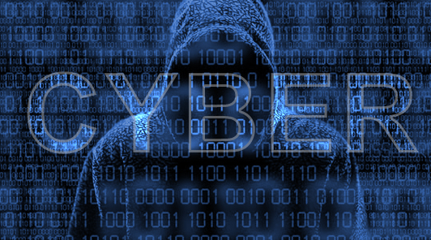
Cyber Breach Incidents Defined
WHO perpetrates
CRIME
WHERE can these risks happen, greatest threat?
vs
TERRORISM
WHAT motivates these criminals
WHEN do they occur? Opportunistic vs Targeted
Notes:
Who, What, Where & When
WHO perpetrates
WHAT motivates these criminals
WHERE can these risks happen, greatest threat?
WHEN do they occur? Opportunistic vs Targeted

Slide 4
Impact of Cyber Breach Incidents
Area | Description
Loss of Confidentiality | Loss of information, critical data, customer information, financial data, etc.
Loss of Integrity | The critical system is in operation but the company cannot control the system or the process; i.e., someone external to the company/entity is controlling the systems
Loss of Availability | Denial of Service Attack System becomes inoperative or ineffective
Destruction of System | Destruction of system
Source: “Protecting Organizations from Cyber Attack, Cliff Glantz and Guy Landine- Pacific Northwest National Laboratory, 2012

Slide 5
Cyber Breach Exposures
At a site
Operating processes
Adjacent to site
Industry and Infrastructure
In proximity to a site
Densely populated areas or natural resources
Business income
Impact of closed operations

Slide 6
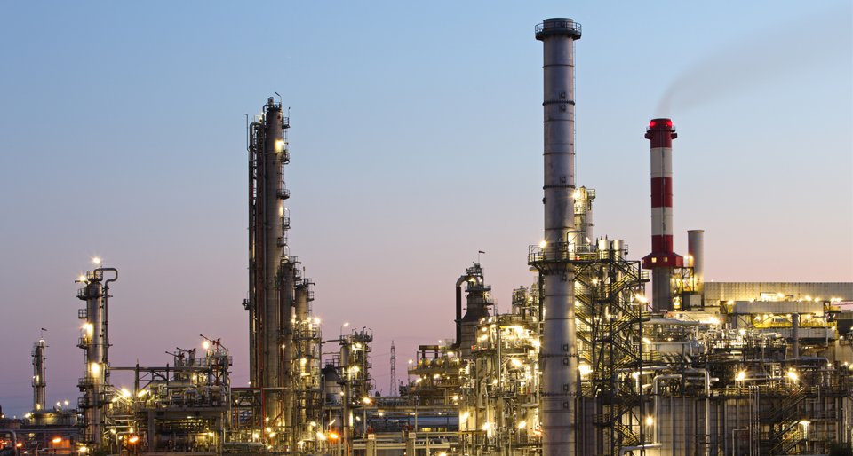
Environmental Insurance
Policy types
Definition of a pollution condition
Basic coverage descriptions
No cyber exclusion!

Slide 7
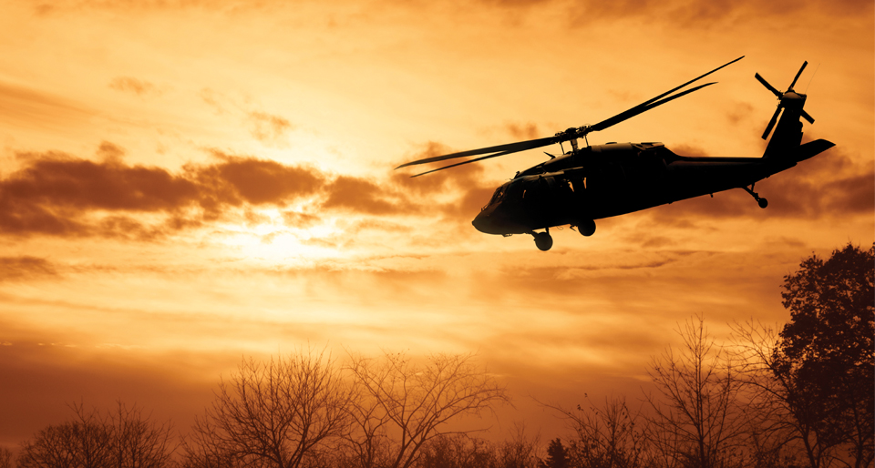
War and Terrorism Exclusions
War Exclusion
Terrorism Exclusion
Terrorism Coverage Grant

Slide 8
Risk Mitigation
Controlling the exposure
Best practices
Loss control
Interdisciplinary coordination
Risk transfer

Slide 9
QUESTIONS?

