Slide 1
Group Umbrella Program

Slide 2







About NFP
NFP is a leading
insurance broker
and consultant.
Our expertise is matched only by our personal commitment
to each client’s
goals.
Through our licensed subsidiaries and affiliates, we provide:
Employee benefits
Property & casualty
Retirement
Individual insurance
Wealth management solutions
4th largest U.S.-based privately owned U.S. broker – Business Insurance

Slide 3
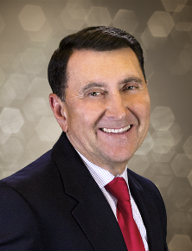
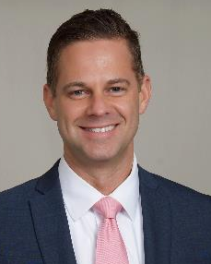
Who We Are
Mike Carmody
Managing Director
843-881-7787
michael.carmody@nfp.com
Southeast & Mid Atlantic Region
Craig Low
Assistant Vice President
214-987-2000
craig.low@nfp.com
Dallas

Slide 5
About Private Client Group
Personal Insurance For Individuals

Slide 6






About Private Client Group
Agency appointments with leading insurance carriers = insurance anywhere in U.S.

Slide 7
About Private Client Group
Three Principles
1
    Our only business is individual P&C insurance.
    We have yet to meet a person who is insensitive to insurance pricing.
    We respect the confidentiality of our clients.
3
2

Slide 8
About Private Client Group
  Undergraduate Degree
  Full Benefits
Our People
  Salary +
  Contribution-Based Bonus
  Above Market Annual Salary

Slide 9
About Private Client Group
Ask Clients
for Referrals
Separate Sales and Service
Attempt to Sell an Additional Line During Service Transactions
What We Don’t Do

Slide 11
Group Personal Umbrella Coverage
What Is It?
Written for a specific and defined group of individuals.
MGA Group Umbrella Program
Wealth Management Firm Clients
Corporation Executives Clients
Family Offices Clients

Slide 12
Group Personal Umbrella Coverage
State of the Market & Carrier Options
Consolidation of carriers created opportunity to develop competing product.
        Chubb Book of Business > $275 Million; Reinsured Within Lloyds Market
        AIG $50 Million Book Being Reduced; Reinsurance Ceded With AIG Subsidiaries
        ACE & FFIC Book < $30 Million; Consolidation into Chubb Book

Slide 13
Group Personal Umbrella Coverage
State of the Market & Carrier Options
NFP PCG + NFP San Francisco affiliate United Advisors = 70+ carriers contracted
Designed policy and underwriting guidelines and brokered reinsurance cover
Process January 2015 – June 1, 2016.
Our vision: Be a major player in partnership with Ironshore, competing directly with “The new Chubb” and others.

Slide 15
Managing General Agent Ironshore Program
Primary Insurance Carrier – Ironshore
Broker-Sourced Specialty Commercial P&C Coverage for Global Risks
Financial Size Category of Class XlV, $1.5 B – $2 B
31
Offices
AM Best “A” Rating / Fitch and S&P Global’s “A+” Rating
U.S., Australia, Bermuda, Canada, Dubai, Hong Kong, Ireland, Singapore, Tokyo, U.K.
Founded 2006

Slide 16
Managing General Agent Ironshore Program
Primary Insurance Carrier – Ironshore
  Reinsurance Cover: Lloyds Syndicates, Liberty, Acapella, Brit, Ren Re, Hiscox, Advent, Barbican and Everest RE
  Participation Based on a Percentage Basis, Assuming Risk From
  $10M – $30M
  Ironshore Retains First $10M
  Reinsurance $10M – $30M

Slide 17
Managing General Agent Ironshore Program
Target Market Minimum Group Premium: $25K With 12 Members
Wide Target Group Size
10M+
Target Market Coverage Limits: $10M+
96%
96% of All Group Clients Purchase Limits $5M – $30M — We Can Place Limits $30M – $100M
Program Is a Commission-Based Product With No Contingency Income

Slide 18
Managing General Agent Ironshore Program
Benefits
$
Eliminates Challenge of Obtaining Higher Coverage Limits In Open Individual Insurance Market
Works with All Providers of Underlying Coverage
Policy Language States Required Underlying Liability Attachment Points to Provide Coverage
No Listing or Monitoring of Underlying Coverage
Discounted Pricing
$

Slide 19
Managing General Agent Ironshore Program
The Big Difference
 | Individual Program | Group Program
Available Limits | Up to $5 Million | Up to $30 Million
Ease of Use | Carrier-driven Paper Process | Web-Based Program
Pricing | Coverage Above $10 Million Averages $500 Per Million | Coverage About $10 Million Averages $150 Per Million

Slide 20
Managing General Agent Ironshore Program
Eligible Program Client Groups
Corporations
Wealth Management
Boards
Executive Associations

Slide 21
Managing General Agent Ironshore Program
Program Premiums
Coverage Limit | Typical Individual Policy Premium | Group Premium
$5 Million | $970 | $650
$10 Million | $2,100 | $1,200
$15 Million | $4,600 | $2,000
$20 Million | $7,100 | $2,600
$25 Million | $9,600 | $3,200
$30 Million | $12,100 | $4,000

Slide 22
Managing General Agent Ironshore Program
Enhanced Coverage for All Liability Policy Limits
$25,000 In Crisis Management Coverage to Mitigate Potential Damages or Injury to Client’s Reputation
Liability Coverage for Volunteer Work for an Organized Nonprofit or Charitable, Religious or Community Group
$1 Million of Uninsured/Underinsured Liability
$25,000 For Private Counsel of Client’s Choice to Review and Consult on Covered Loss
Personal Injury
(Libel And Slander)

Slide 23
Managing General Agent Ironshore Program
Optional Coverages
Employment Practices Liability
Uninsured/Underinsured Liability
Nonprofit Directors and Officers Liability
Family Trustee Cover

Slide 24
Managing General Agent Ironshore Program
Administration & Website
Secure Website Developed / Maintained by Third Party Chicago-Based Kona
Kona 100% Certified Through the Illinois Department of Central Management Services
Kona CEO & Founder Kelly Cutler – konacompany.com
Proprietary Application System
  Client completed application, selects coverage and pays for coverage in approx. 10 minutes
  Five credit card payment options or online ACH payment
  Print or PDF documents
Kona 100% Certified Through the Women’s Business Enterprise National Council

Slide 25
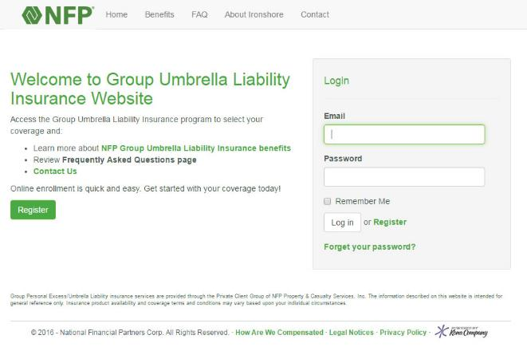
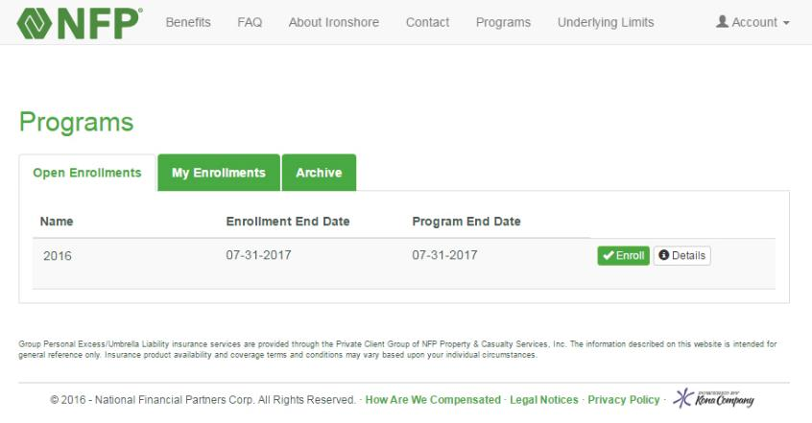
Managing General Agent Ironshore Program
Administration & Website

Slide 26
Thank You.

