Slide 1
Trevor Mickelson
CPA Practice Leader
720-490-4531
Trevor.Mickelson@AgilityRecovery.com

Slide 2

Trevor Mickelson – Who?

Slide 3

Trevor Mickelson – Who?

Slide 4
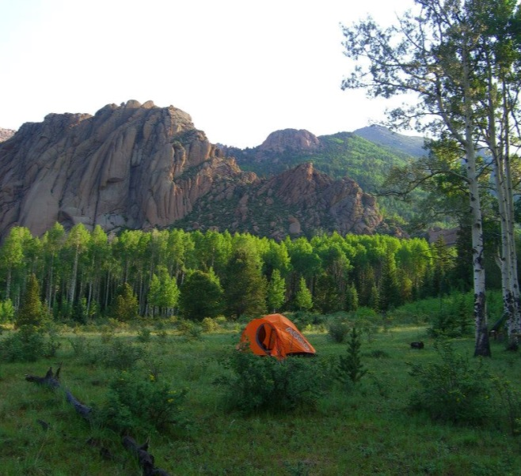

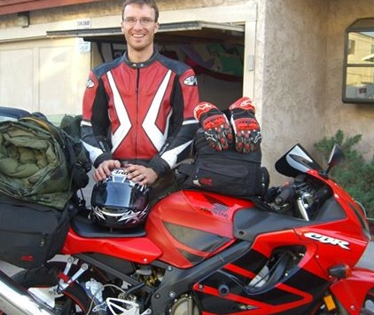

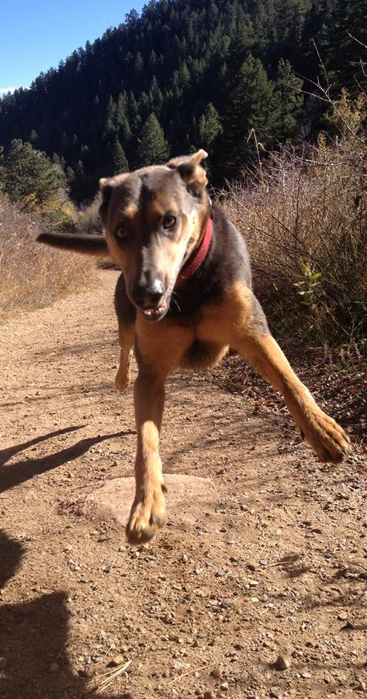


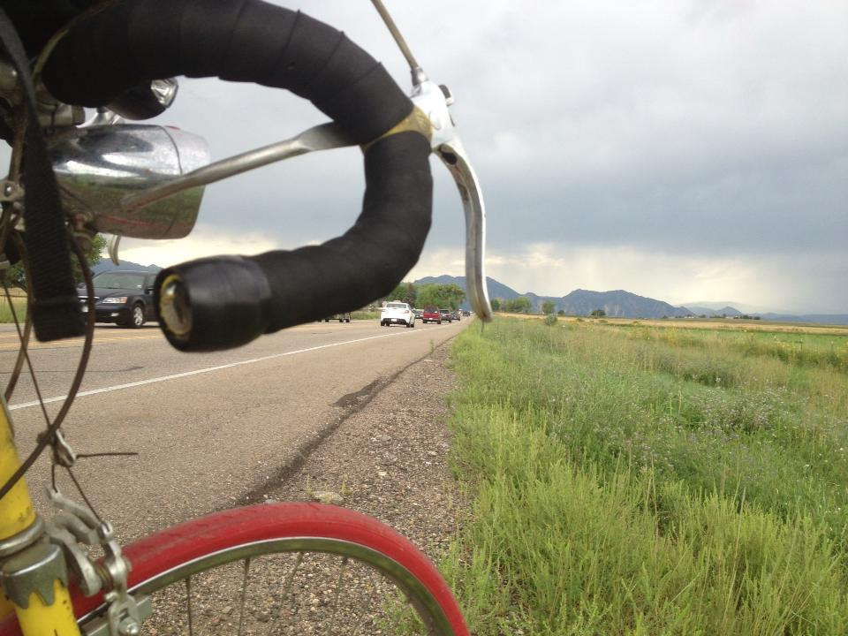
Trevor Mickelson – Who?

Slide 5
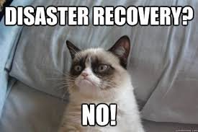
Rule #1 - Don’t Be Grumpy

Slide 6
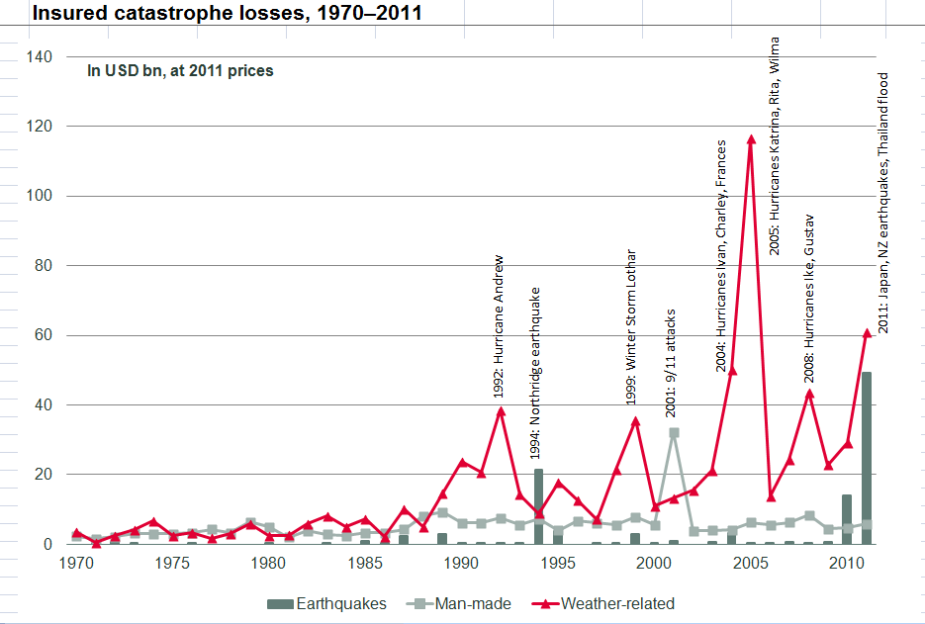
US Billion Cost of Disasters
Image fills this entire area
(OR originates at the upper left corner of the area
outlined and is sized to the full width or height of this
bounding box.)
Source: Swiss Re (sigma issue 1/2011)

Slide 7
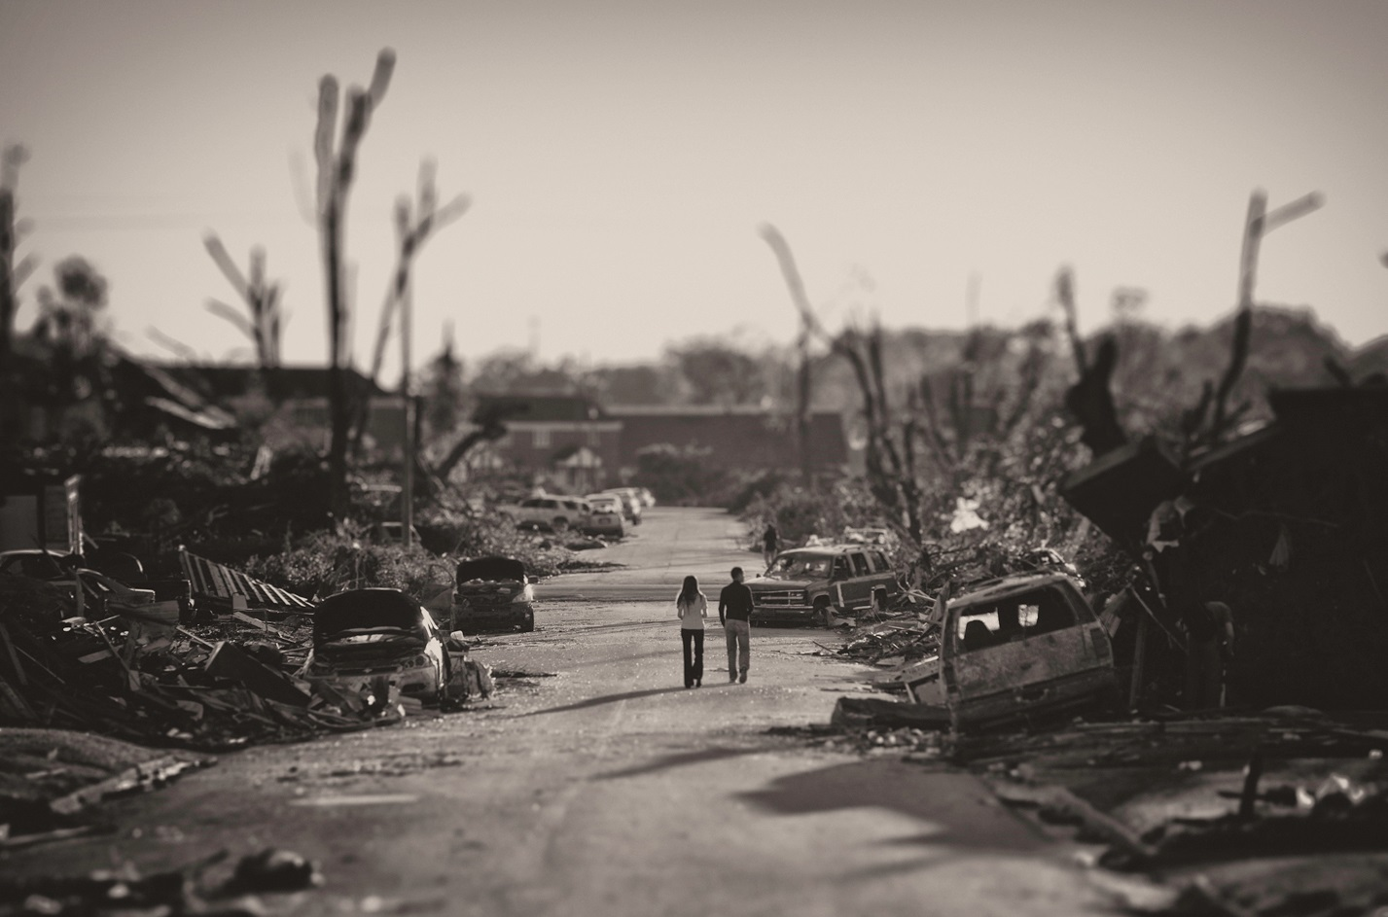
Agility Recovery - History
Started by General Electric 25 years ago.
Saw a need to recover at or near the businesses’ normal location.
Photo taken by
Agility Recovery team

Slide 8






















Partners – Endorsements

Slide 9

Insurance Endorsements and Partners

Slide 10
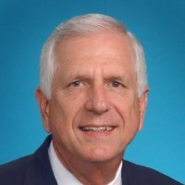
Tom Meckley
Agility Recovery Solutions
Consultant 10 Years
Retired partner of Ernst & Young LLP
38 year career
15 years as Managing Partner – PA & NC
The Cato Corporation - Current
Board of Directors - Chairman of Audit Committee
AICPA
Member of Governing Council 1999-2001
NCACPA
Board of Directors 1993-1998
State President 1996-97
Recipient of “Raymond Rains Outstanding Service to the Profession Award” May 2005

Slide 11
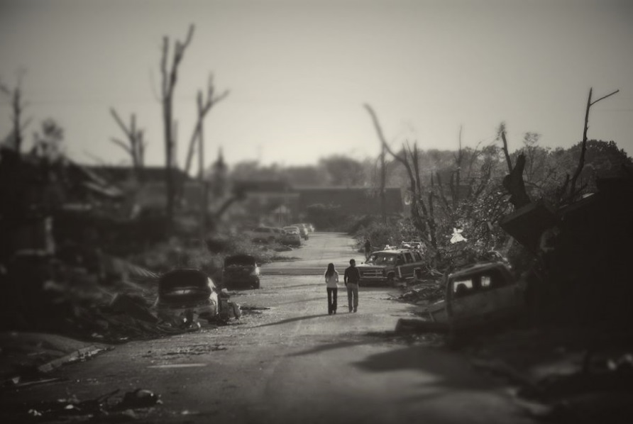
Agility Recovery
Started by General Electric 25 years ago.
GE internally identified need to support themselves.
Office Space
Power
Communications
Computer Systems
Photo taken by
Agility Recovery team

Slide 12

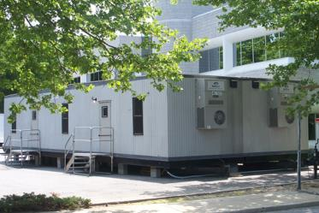
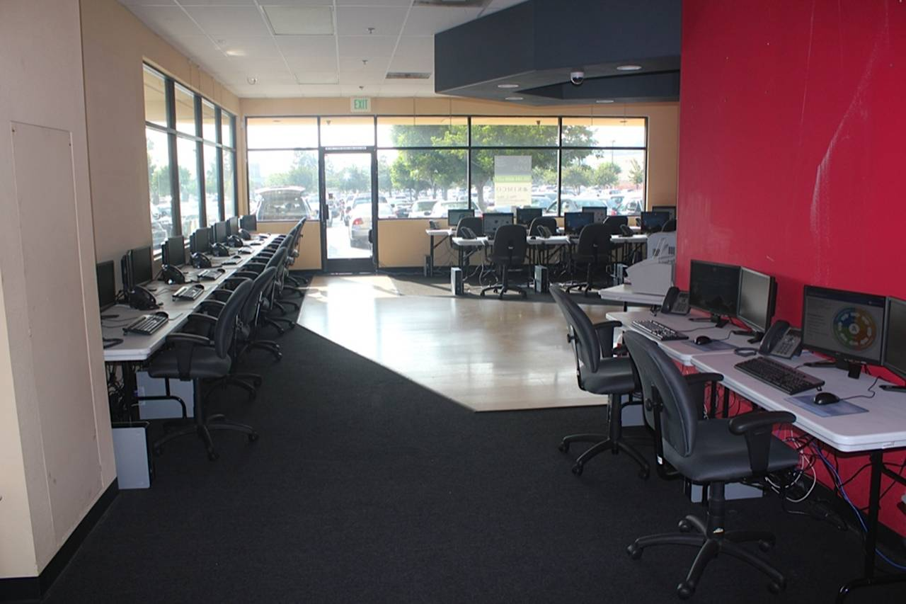
Space – Power – Communications – Technology
Agility’s Mobile Offices
Flexible, scalable, customizable
Brick & Mortar Space
Approximately 200 Million ft² vacant office space available across North America.

Slide 13
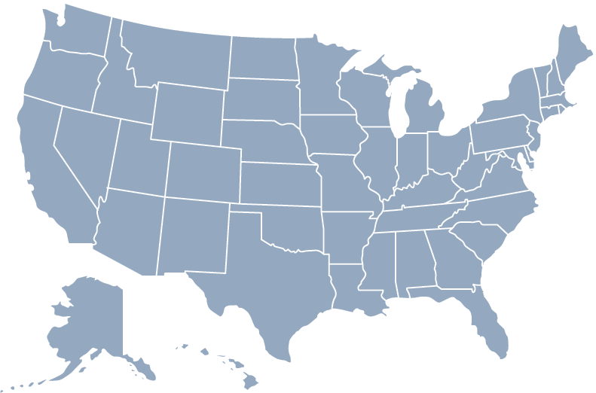
Space – Power – Communications – Technology
  Agility can provide:
  Any size Generator
  Fuel
  Technical support
  Service
  Connection Options:
  Hardwire
  Power Distribution with extension cords
  Transfer Switch
Generator Yards in North America

Slide 14




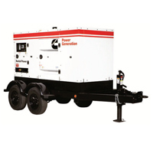
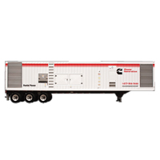
Agility’s Partners in Power Recovery
- National Account Management
Access to Full Fleet Services
Discounted Pricing 20-30%
Preferred Customer
GPS Tracking
Trucking and Logistics
Online Portal Management
Re-Fueling
From 40kw to 2000kw

Slide 15




Space – Power – Communications – Technology
Satellite communication provides instant access to phone and Internet service.

Slide 16
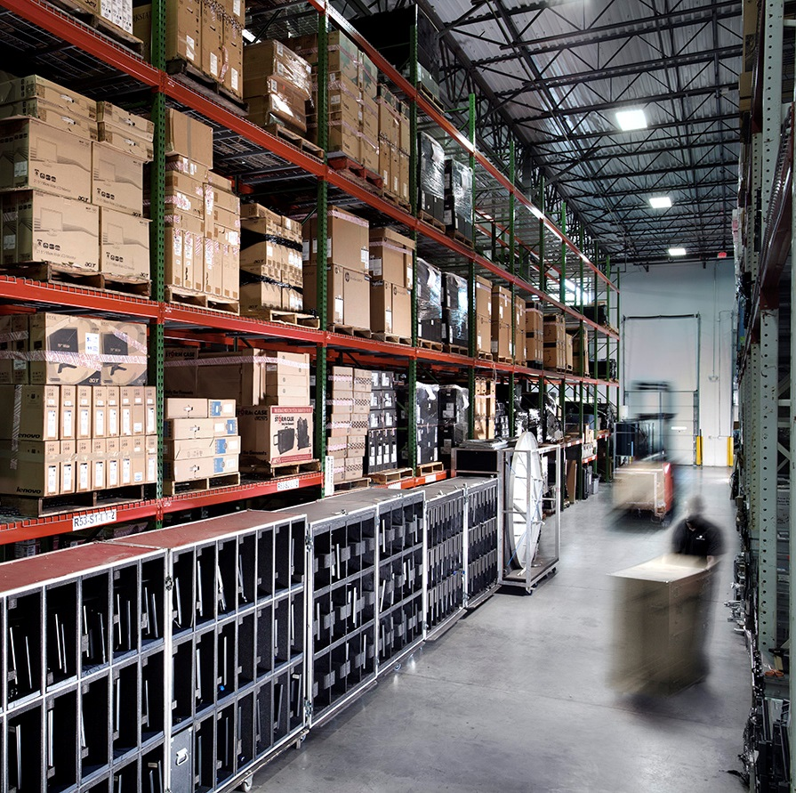
Culture of Success
General Electric built an
infrastructure to ensure success
25 years
Rescued 1000’s of businesses
Never failed
Atlanta Distribution Center

Slide 17

New Vision
The industry focused on the needs of the Fortune 500.
This model is too expensive for most businesses.
In 2004, Agility defined a new vision.
Agility will bring disaster recovery solutions to
ALL businesses.

Slide 18

New Business Model - ReadySuite
Agility created a solution that all business could afford.
For a small monthly fee, normally $495/month,
you can protect your business.
Most organizations spend less for Agility then they do for Coffee/month.

Slide 19

When You Become a Member
A continuity planner will contact you and gather the info we need to recover your business if you have a disaster. e.g.
How many critical employees need to be up and running?
What are the power requirements of the office?
Where do you store your data?
How do you want your phone calls handled during a disaster?
Ben Pritchard Member Services

Slide 20
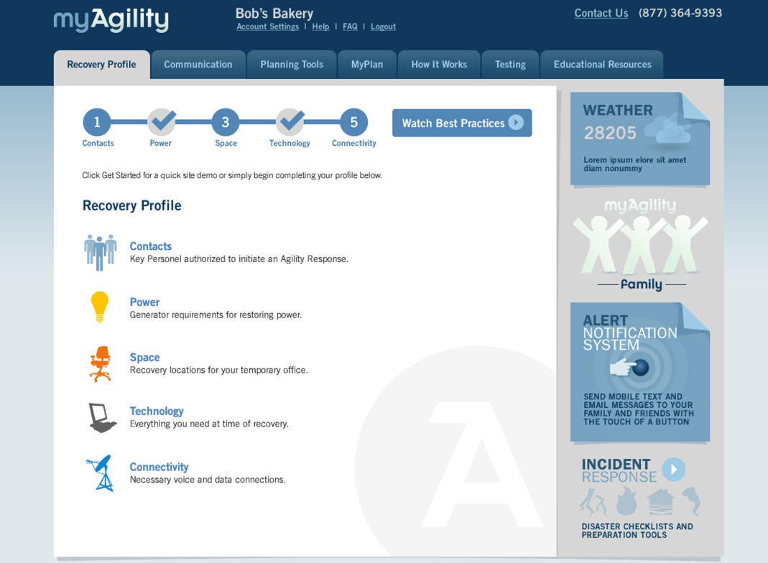
When You Become a Member
All information is placed in a password protected site called myAgility.
myAgility is the foundation of your recovery plan.

Slide 21
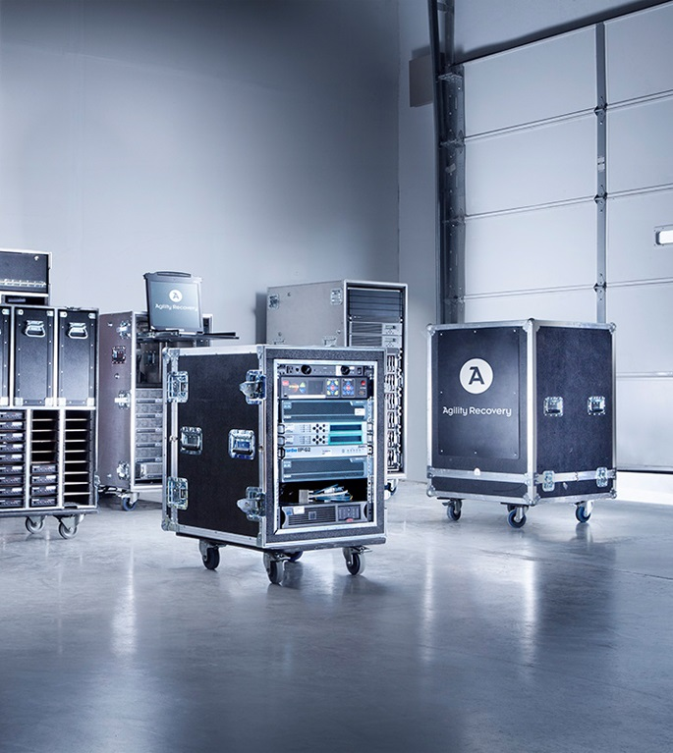
When You Have A Disaster
Agility’s operations team works with you to determine your needs.
You only pay for Agility’s
out-of-pocket expenses:
If we fly a technician to your office to set-up computers, we charge you for the airfare, but not the time.
If you need a generator, we'll deliver it and bill you our exact costs.
If you need a server, we take one from our stock and ship it to you. You pay for the shipping.
Agility Quickship Cases

Slide 22
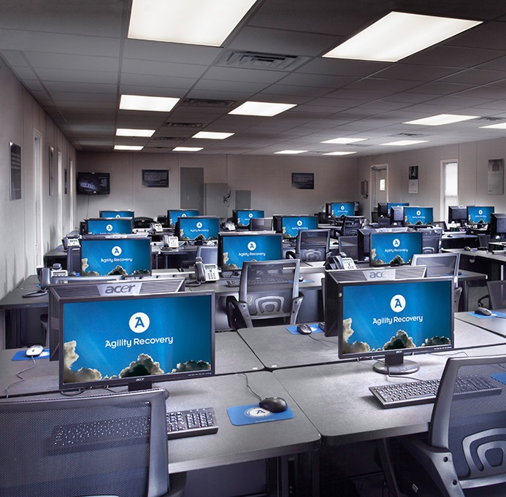
When You Have A Disaster
Regardless if you have Agility or not, you would still have the same recovery needs.
But Agility will get it done faster, cheaper and more effectively.
Most importantly, we get it done every time.
ReadySuite Mobile Office

Slide 23
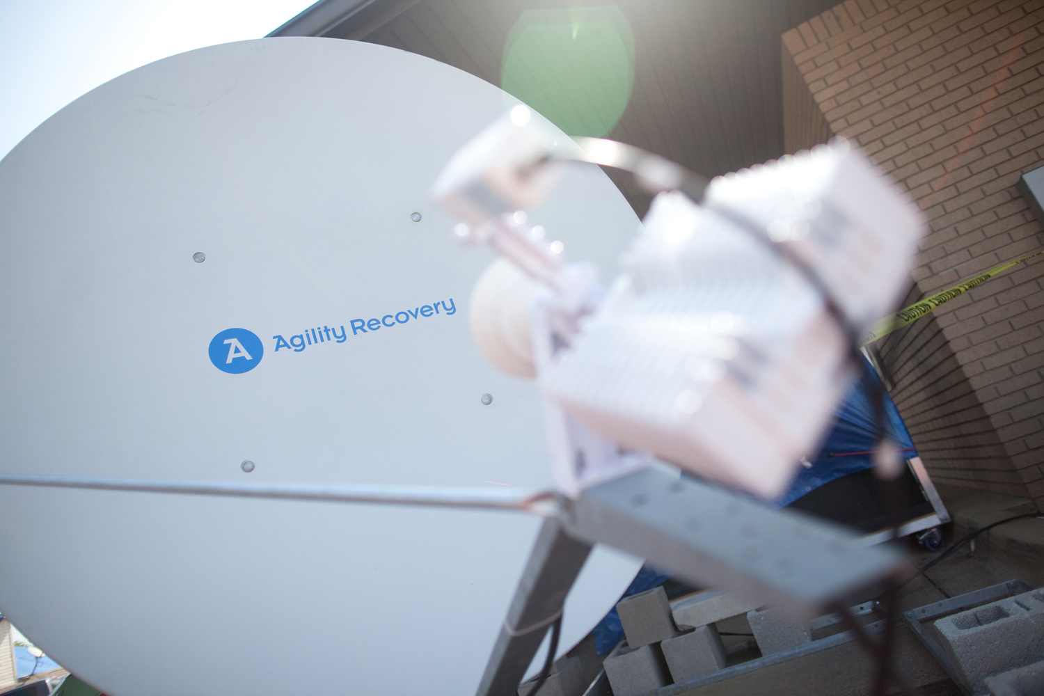
Disasters Happen
Sometimes they’re small like a phone outage.

Slide 24
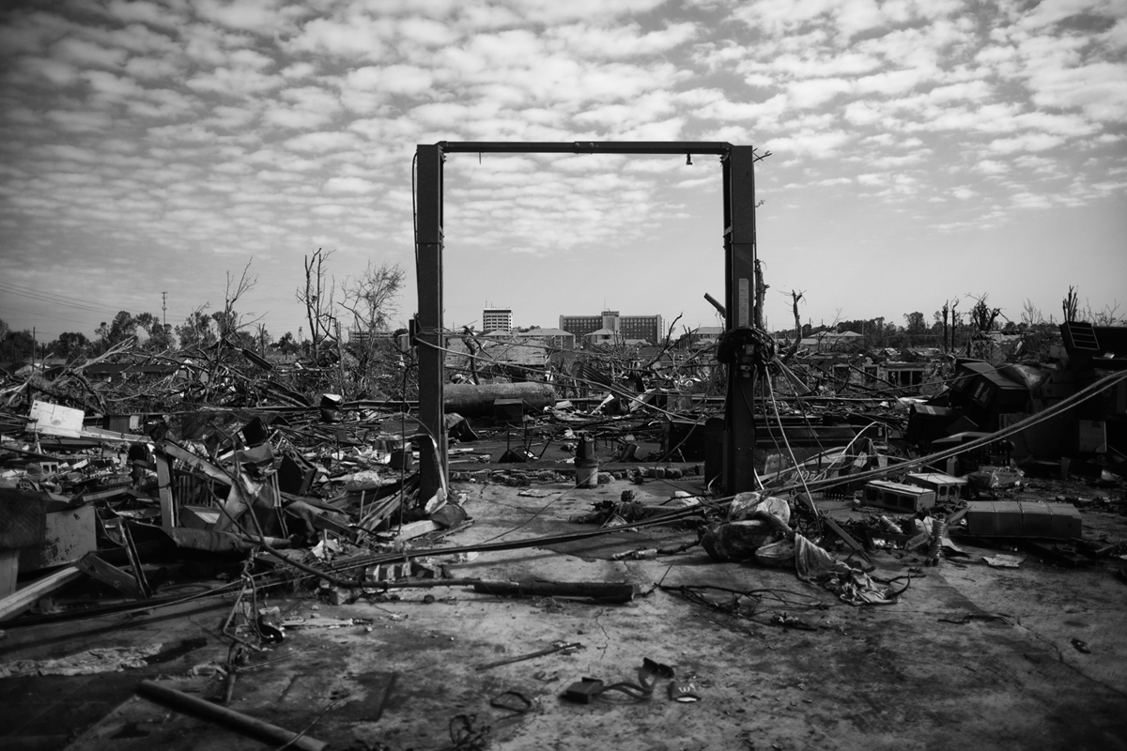
Disasters Happen
Sometimes they’re big like a tornado.
Photo taken by
Agility Recovery team

Slide 25
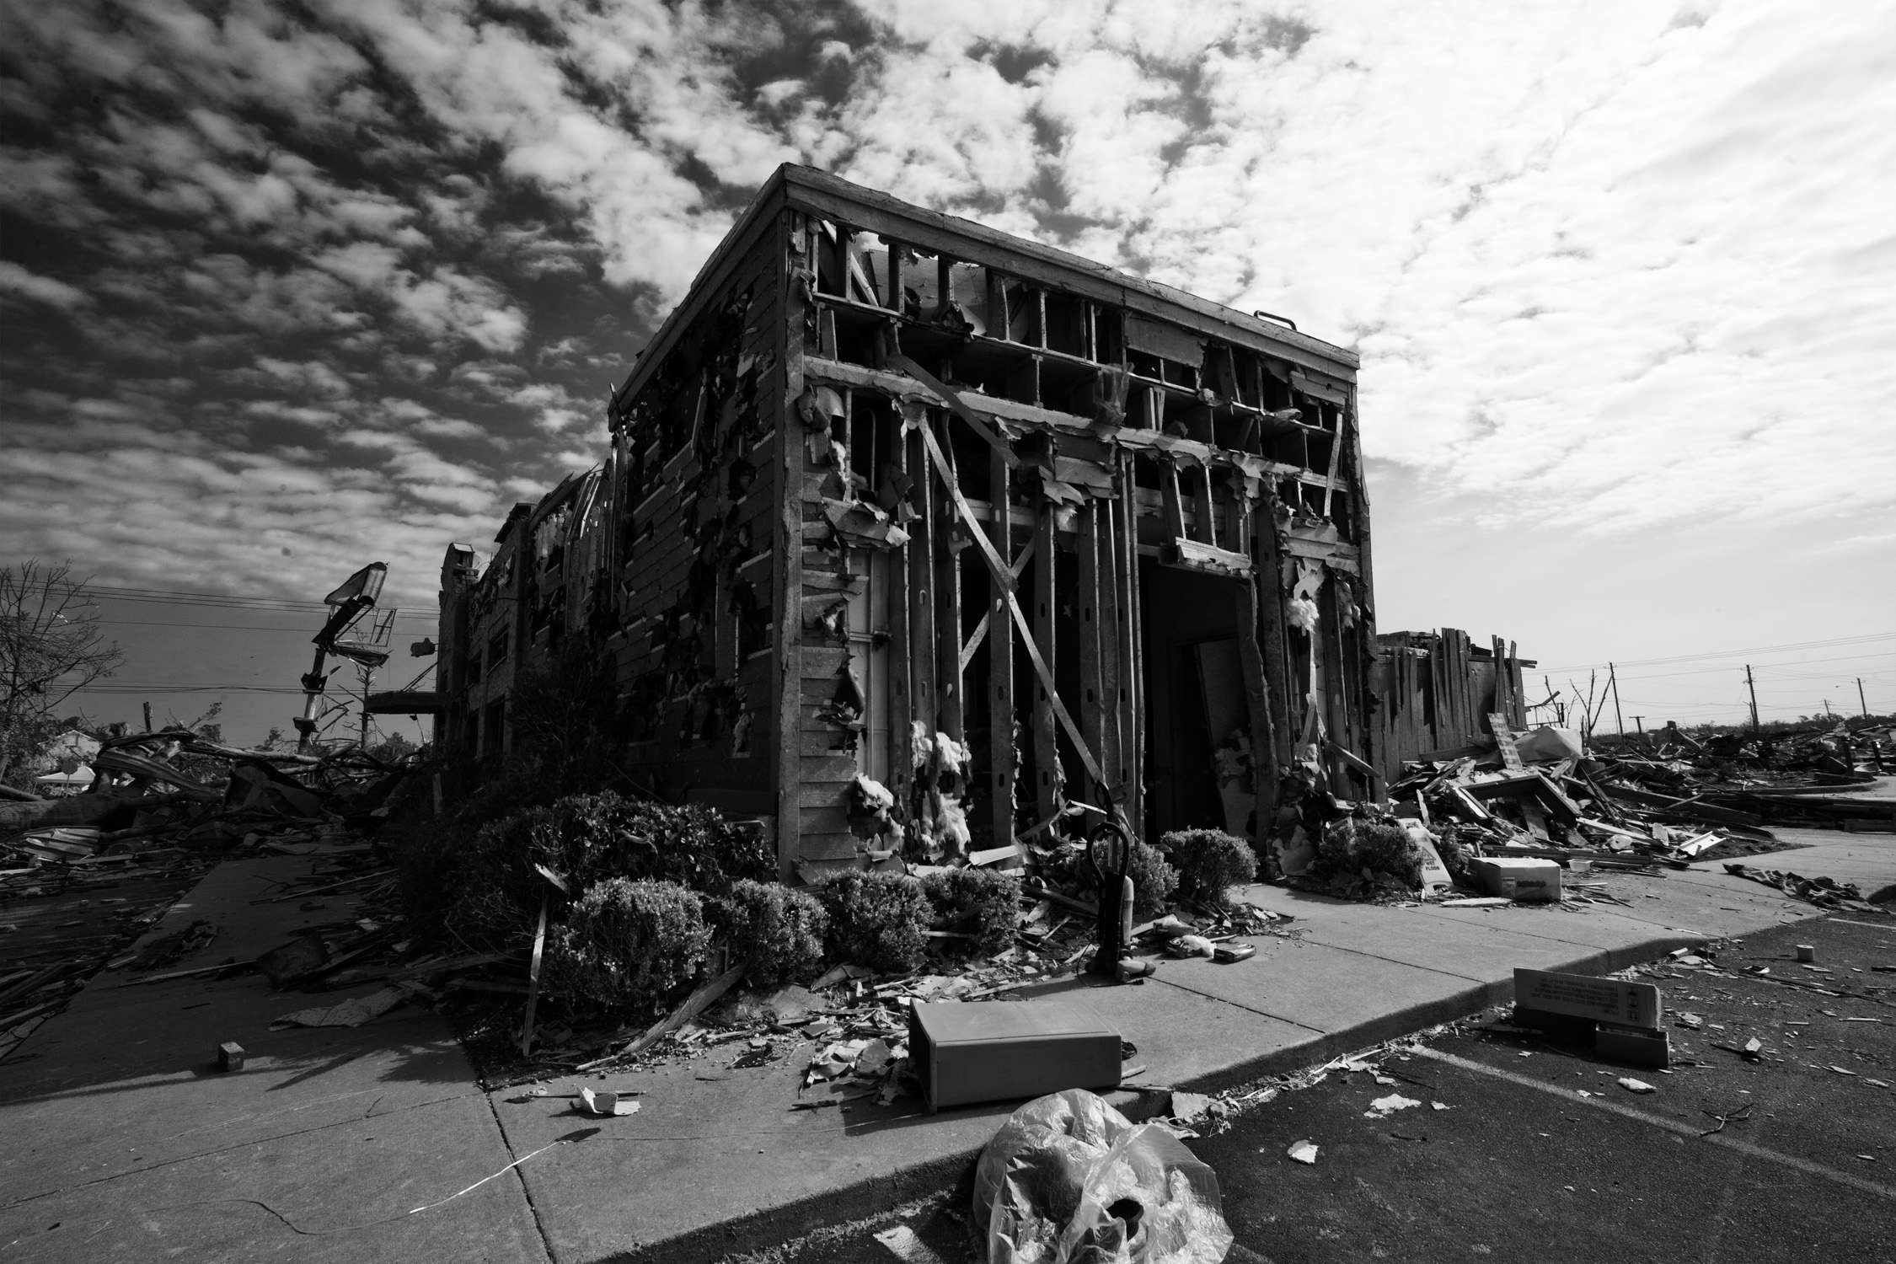
Disasters Happen
If you don’t have a plan your business will be
forever altered.
Photo taken by
Agility Recovery team

Slide 26
The Reality – Disasters Happen Everyday
A/C Failure
Arson
Asbestos
Bomb Threat
Bomb Blast
Brown Out
Burst Pipe
Cable Cut
Chemical Spill
CO Fire
Communication Failure
Condensation
Construction
Coolant Leak
Corrupted Data
Diesel Generator
Electrical Short
Evacuation
Explosion
Fire
Flood
Fraud
Frozen Pipes
Hacker
Hail Storm
Halon Discharge
Human Error
Humidity
HVAC Failure
Ice Storm
Insects
Landlord Conflict
Lightning
Lost Data
Microwave Fade
Network Failure
PCB Contamination
Plane Crash
Power Outage
Power Spike
Power Surge
Programmer Error
Raw Sewage
Relocation Delay
Rodents
Roof Cave In
Sabotage
Shredded Data
Sick building
Smoke Damage
Snow Storm
Faulty Sprinkler
Static Electricity
Strike Action
Terrorism
Theft
Toilet Overflow
Tornado
Train Derailment
Transformer Fire
UPS Failure
Vandalism
Vehicle Crash
Virus
Water (Various)
Wind Storm
Volcano
Epidemic – H1N1
Agility has NO exclusions

Slide 27

Disasters Happen
During a disaster there are more important things to focus on instead of trying to rebuild your infrastructure.
When you’re most vulnerable to being overcharged and underserved, you will have a partner you can trust:
  25 years
  1000’s of recoveries
  Never failed
Agility will never profit from your disaster.
Bobbi Carruth Agility Member
Worthington Federal Bank

Slide 28
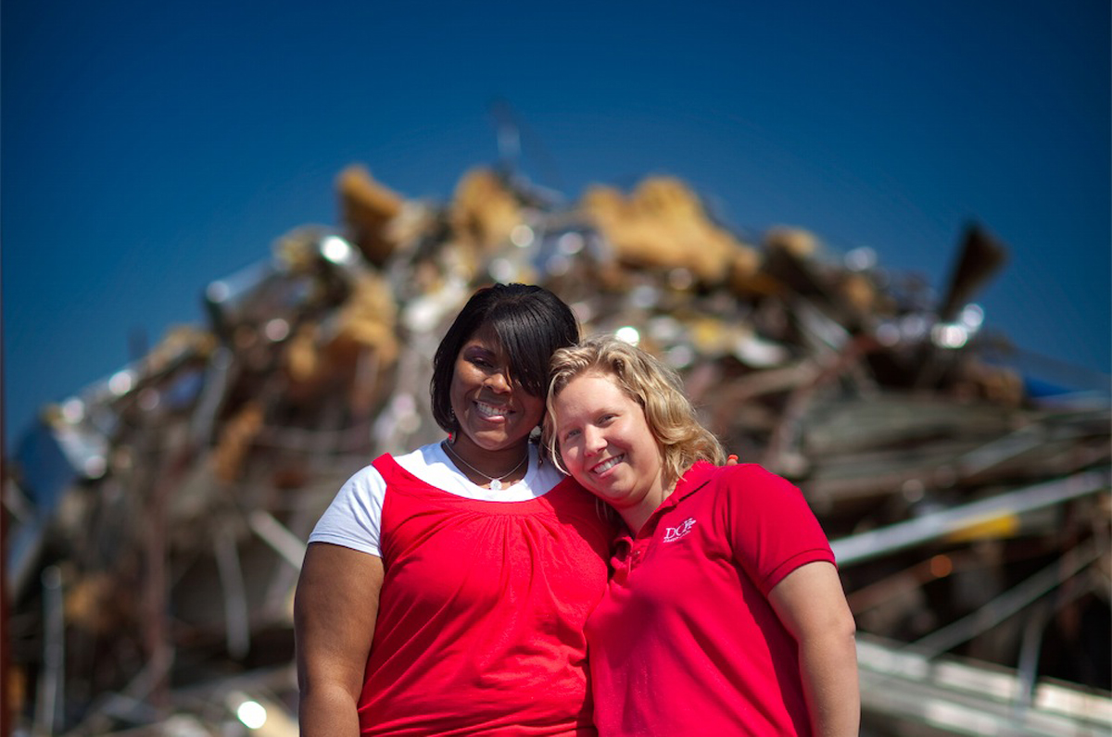
Ask Yourself…
Do you believe a disaster could happen?
Do you believe that without a plan, your business will suffer?
Do you believe Agility, after 25 years and 1000’s of recoveries
will be there?
DCH Credit Union Agility Members
Tornado Recovery

Slide 29
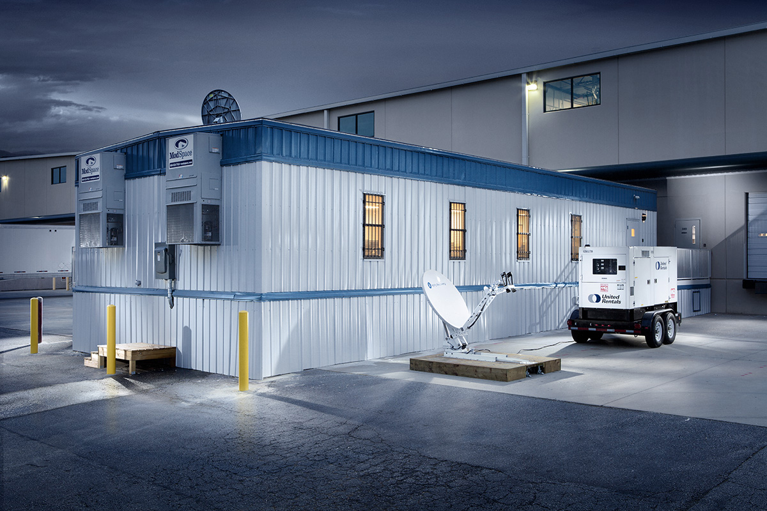
Ask Yourself – Do You Believe?
If you answered, “Yes,” then Agility is a fairly easy decision.
We welcome you as a member.

Slide 30
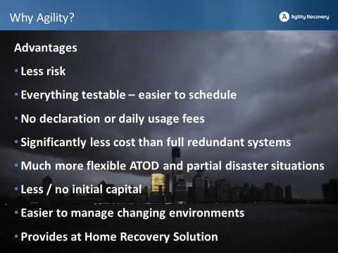

Slide 31
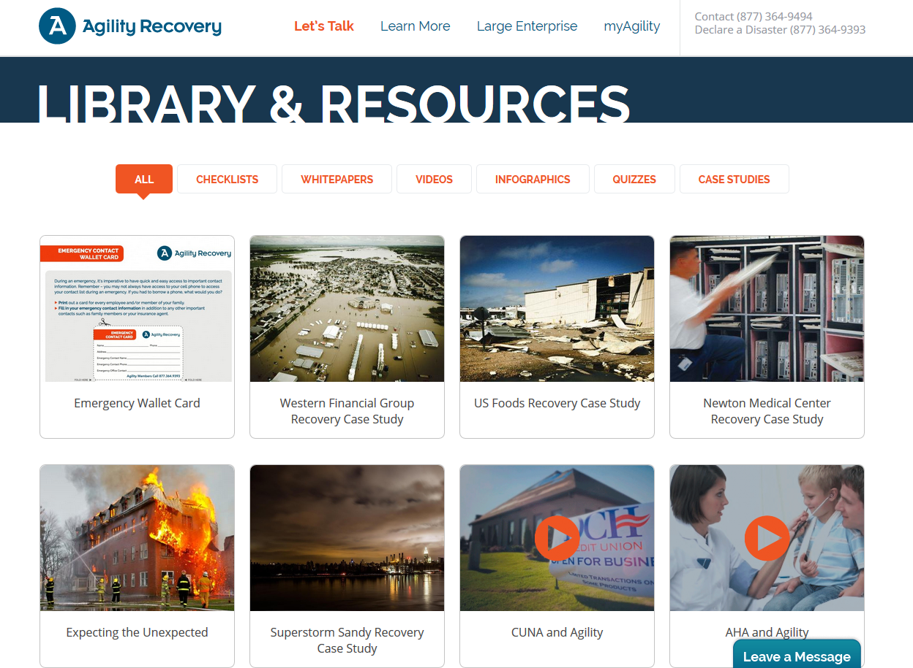
www.AgilityRecovery.com

Slide 32

www.AgilityRecovery.com

Slide 33
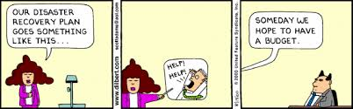
Notes:
Instructions for upper management to manage the emergency response internally and with the public

Slide 34


Prepare to survive.
For over twenty-five years, tens of thousands
of businesses have relied on Agility
to help plan for and recover from the unthinkable.
We’re ready when you are.
QUESTIONS?
Trevor Mickelson - 720-490-4531
CPA Practice Leader
Trevor.Mickelson@AgilityRecovery.com

