Slide 1


PASSION.
INNOVATION.
ACCOUNTABILITY.
BEECHER CARLSON
BEECHER CARLSON CAPABILITIES PRESENTATION
Risk management without passion, innovation and accountability is just buying insurance.

Slide 2

Agenda
PRESENTATION Agenda
 | Introduction to Beecher Carlson
 | Property Capabilities
 | Executive Liability Capabilities: D&O, EPLI & Fiduciary
 | Executive Liability Capabilities: E&O – Cyber Risks
 | DBA & Foreign Ops
 | Captive Capabilities
 | Environmental Capabilities
 | Casualty Capabilities & Industry Update
 | Beecher Carlson’s World Class Broking
 | ZOOM®
1
2
PASSION.
3
INNOVATION.
4
ACCOUNTABILITY.
5
6
7
8
9
10
2

Slide 3






ZOOM® | Patent pending process that combines the science of predictive analytics and data mining with hands-on claims consulting and loss control engineering expertise
PULSE | Browser-based solution automated to all functions of your medical malpractice insurance policy allowing healthcare facilities and professionals to self-service accounts and bind medical malpractice coverage online
NOVUS | Browser-based tool with a completely traceable paperless process preserving data integrity, enhancing communication and keeping clients, insurers and broker in sync
RISK CONCIERGE | Web-based system that puts your data in one place so you can easily access and manage the effectiveness of your risk management program, analyze claims issues and structure your program
Introduction to Beecher Carlson
1
MARA
MARA | Multivariate Algorithm for Risk Analysis (MARA) evaluates approximately 4,000 metrics to determine and assess your company’s risk drivers
LiNK | Proprietary methodology enables you to accurately apportion the true cost of your premium among your property locations – all based on your chosen criteria
passion. innovation. accountability.

Slide 4
Beecher Carlson / Brown & Brown
Beecher Carlson
Property & Casualty Focused
Risk Management/Large Account focused
Industry Focused (6 Core Verticals)
Product Expertise
Loss Sensitive Programs
Captive Management
In house Loss Control/Claims Advocacy
Direct Access to Domestic/Bermuda
Min. Account Premiums - $300,000+
Work primarily with National/Global insurance providers
Fee or Commission based compensation
22 locations in US/Bermuda
Largest Competitors (Marsh, Aon, Willis)
Brown & Brown
Middle Market P&C, Employee Benefits and Personal Lines
Middle Market placement focused
Generalists / Local
Guaranteed Cost Programs (primarily)
Utilize the insurance carriers to perform loss control and claims services
Direct access to most domestic markets including regional markets
Min. Account Premiums - $15,000+
Work primarily with Regional and National insurance providers
Commission based compensation
102 Retail locations in US, 76 non-retail locations (Services, Programs, Wholesale) 1 location in London.
Largest Competitors (Bank Owned Insurance Agencies, Local Insurance Agencies)

Slide 5
Combining the National Strength of Brown & Brown with the specialization of Beecher Carlson
Why Brown & Brown acquired Beecher Carlson in 2013.
BC was one of the fastest growing commercial brokerage firms and the 27th largest in the U.S.
BC was growing at a CAGR of 27.5% from 2003-2012 despite macroeconomic challenges from 2009-2011 and soft P&C market conditions.
BC had a proven ability to win share from global competitors (Marsh, AON, Willis)
BC had 38 Risk and Insurance Power Brokers Winners since 2009.
BC had industry leading, proprietary technology innovations that address the various risk & program management needs of target markets.
BC had a specialized business model built around focused industry and product groups.
BC achieved in excess of 95% client retention each and every year since 2003.

Slide 6
Business Insurance Rankings
July 21, 2014
www.business insurance.com
SPECIAL REPORT
100 LARGEST BROKERS
Ranked by 2013 brokerage revenue
2014 rank | 2013 rank | Company | 2013 U.S. broker revenue | % change
1 | 1 | Aon P.L.C. | $5,561,106,600 | 4.6%
2 | 2 | Marsh & McLennan Cos. Inc.¹ | $5,521,500,000 | 5.2%
3 | 3 | Arthur J. Gallagher & Co.¹ | $2,111,340,000 | 10.7%
4 | 4 | Willis Group Holdings P.L.C. | $1,743,840,000 | 7.3%
5 | 6 | BB&T Insurance Holdings, Inc.¹ | $1,582,443,400 | 6.9%
6 | 7 | Brown & Brown Inc. | $1,355,502,535 | 14.0%**
7 | 5 | Wells Fargo Insurance Services USA Inc. | $1,350,022,000 | (14.3%)
8 | 8 | Lockton Cos. LLC² | $826,448,280 | 12.4%**
9 | 10 | USI Holdings Corp.¹ | $782,207,827 | 9.8%
10 | 11 | Hub International Ltd.¹ | $768,865,200 | 21.5%**

Slide 7
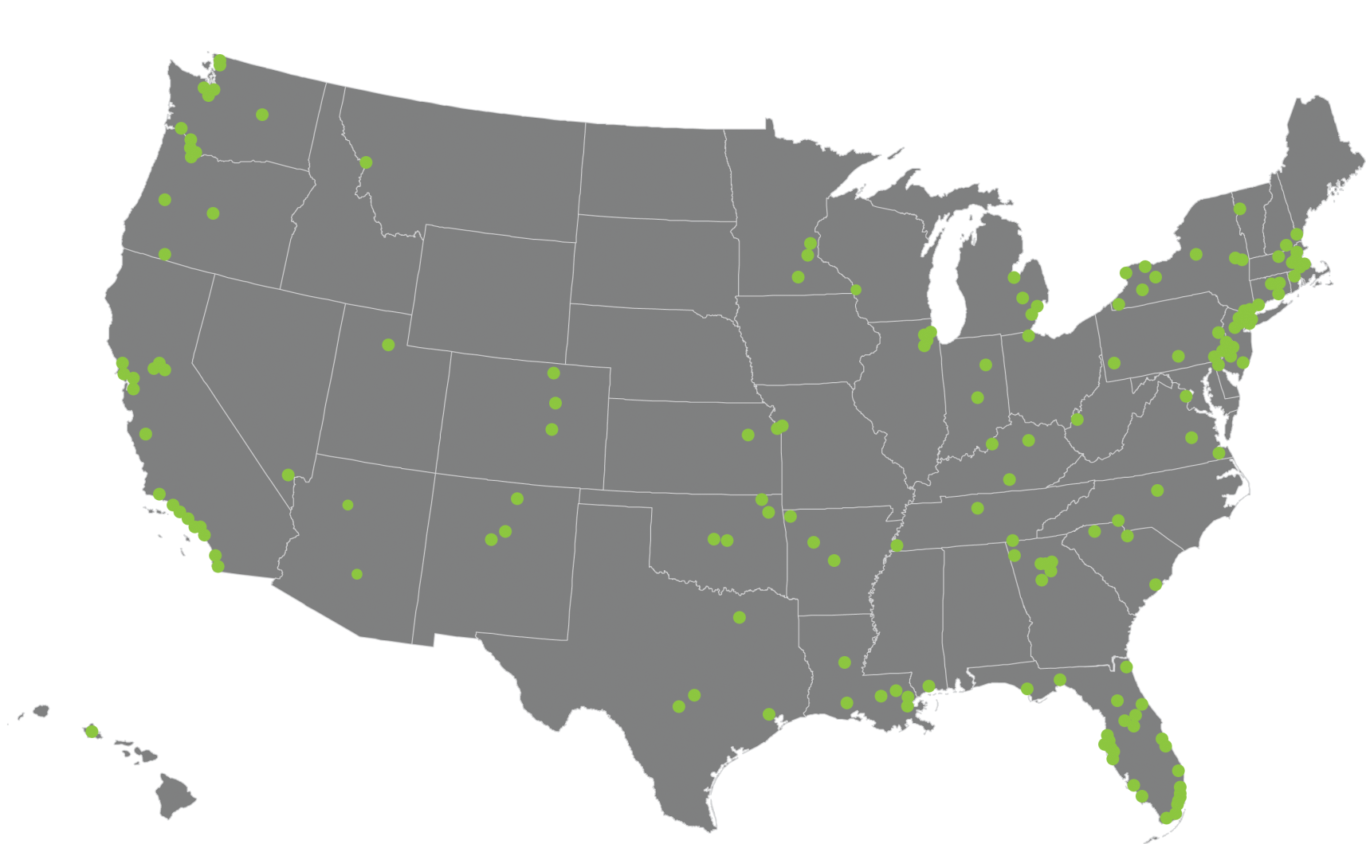
Beecher Carlson/Brown & Brown
Domestic Footprint
Beecher Carlson is a large account risk management broker that delivers expertise by industry focus and product specialization. By leveraging our deep risk management expertise, we are able to help clients manage their business risks, protect and enhance their capital and fulfill their corporate mission. Beecher Carlson is a subsidiary of Brown & Brown, Inc. and headquartered in Atlanta, GA. Headquartered in Daytona Beach, FL, Brown & Brown is one of the nation’s leading independent insurance intermediaries and is ranked as the sixth largest insurance brokerage in the United States and the seventh largest brokerage worldwide by Business Insurance magazine. Brown & Brown is a $1.6B revenue broker placing more than $12B of premium into the market.

Slide 8
Beecher Carlson Principles
BEECHER CARLSON Principles
1
2
3
Passion
Innovation
Accountability
We believe risk management without
passion, innovation and accountability is just buying insurance.

Slide 9

1
Passion
BEECHER CARLSON Principles
We are passionate about providing an
experience that goes beyond transactions.

Slide 10



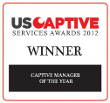



BEECHER CARLSON
Awards
Ranked #1 in Innovation in Captive Management by U.S. Captive for 2013
AutoZone's 2013 Partner Excellence Award
Award recognizes high performing partners that are leading in their industry
PARTNER EXCELLENCE AWARD
Top Insurance and Professional Services Organizations for Diversity and Inclusiveness recognized by Exelon
Captive Manager of the Year 2012
Recognized excellence in the delivery and management of captive insurance
Ranked #1 in Favorability by Greenwich Associates in 2011 based on the key attributes of:
Ethicality, Flexibility, Likelihood to Recommend, Client Satisfaction, Prompt Follow-up, Addressing Policy Issues with Adequate Time Before Renewal, Compensation and Pricing, Innovativeness of Brokerage
Business Insurance’s Readers Choice Award 2010 was based on the best combination of:
Innovation, Service, Quality and Value
Ranked #1 in Favorability by Greenwich Associates in 2010 based on the Key attributes of:
Customer Service, Ease of Working Relations, Flexibility, Securing Best Prices and Understanding Business Needs
Business Insurance’s Readers Choice Award 2009 was based on the best combination of:
Innovation, Service, Quality and Value
We demand more and are recognized for it.

Slide 11
2
Innovation
BEECHER CARLSON Principles
Embracing innovative thinking,
we strive to develop new and better technologies.

Slide 12
BEECHER CARLSON Innovation
Embracing innovative thinking,
we strive to develop new and better technologies.

Slide 13
3
Accountability
BEECHER CARLSON Principles
We are accountable to our clients and align
ourselves to meet their objectives, regardless of geography.

Slide 14


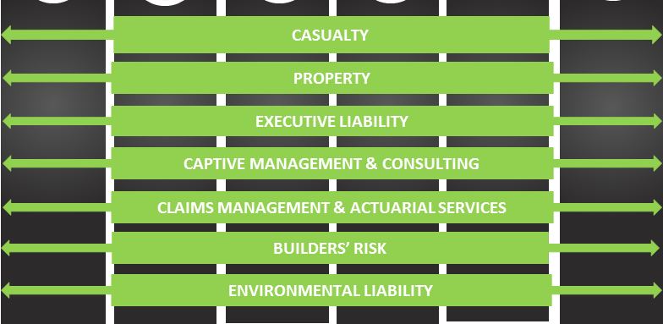
SPECIALIZED Insurance Brokerage
ENERGY
FINANCIAL SERVICES
HEALTHCARE
HOSPITALITY
MANUFACTURING
REAL ESTATE
We specialize in specific industry verticals, and our brokerage teams further focus on specific product lines within those industries.
Specialization has given Beecher Carlson true expertise in our markets, allowing us to offer differentiated, customized and value–added client solutions.

Slide 15



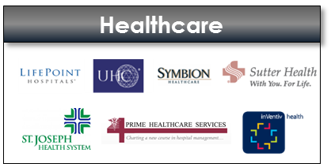




Beecher Carlson Sample Client List
Sample Client List

Slide 16
ZOOM® | Patent pending process that combines the science of predictive analytics and data mining with hands-on claims consulting and loss control engineering expertise
PULSE | Browser-based solution automated to all functions of your medical malpractice insurance policy allowing healthcare facilities and professionals to self-service accounts and bind medical malpractice coverage online
NOVUS | Browser-based tool with a completely traceable paperless process preserving data integrity, enhancing communication and keeping clients, insurers and broker in sync
RISK CONCIERGE | Web-based system that puts your data in one place so you can easily access and manage the effectiveness of your risk management program, analyze claims issues and structure your program
Property Capabilities
2
MARA
MARA | Multivariate Algorithm for Risk Analysis (MARA) evaluates approximately 4,000 metrics to determine and assess your company’s risk drivers
LiNK | Proprietary methodology enables you to accurately apportion the true cost of your premium among your property locations – all based on your chosen criteria
passion. innovation. accountability.

Slide 17
Broking Style
We challenge every aspect of your program to build market
momentum through an integrated team approach.
Pre-Underwrite Each Risk
  Analyze the Total Insurable Values (TIV)
  Determine the MFL and PML estimates for “critical” exposures
  Review the historical loss records
  Examine available engineering/loss control reports
  BI values and geo-radius tool
Advantages Gained from Pre-Underwriting
  Determine the appropriate amount of “critical” limits to purchase
  Proper layer breakpoints
  Layering structure (i.e. quota share or “stacked” layers)
  Potential roadblocks are identified to help better position your company
  Identify and reach target markets
  Identify target pricing

Slide 18
HOW WE ACCESS The Marketplace
Beecher Carlson
Domestic Marketplace
Domestic Wholesale
Broker
London Broker
Bermuda Broker
Excess & Surplus
Lloyds of London /
European Markets
Bermuda Markets
Why Direct?
Facilitates the insured’s ability to interface with their underwriters.
Direct negotiations with underwriters maintains control over what message is being delivered to the markets.
Reduced frictional costs. Wholesale brokers should only be utilized for those markets retail brokers cannot approach on
a direct basis.
We have access points at the highest levels of all major carriers.

Slide 19
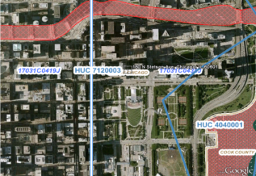
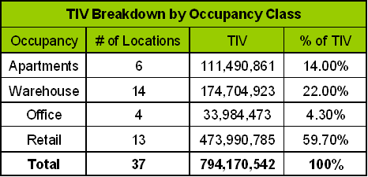
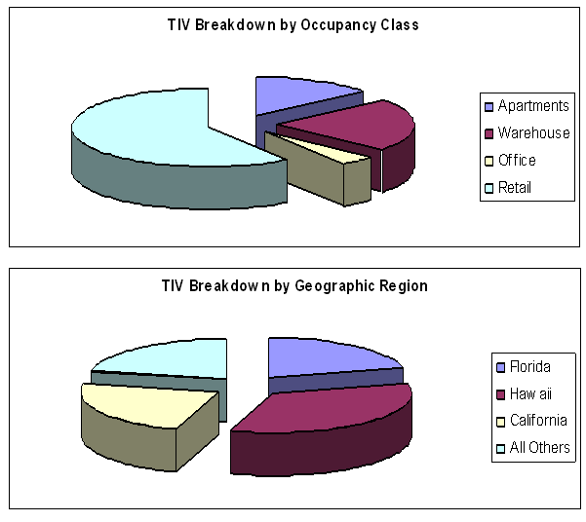
Our Technology and Risk Modeling Solutions
Claims
Loss control
RMS – Catastrophe modeling
Mapping capabilities
Radius Tool
Google Earth Pro – “Not your desktop Google Earth”
Premium allocation
LiNK - Proprietary rating tool

Slide 20
RMS – Catastrophe Modeling

Slide 21
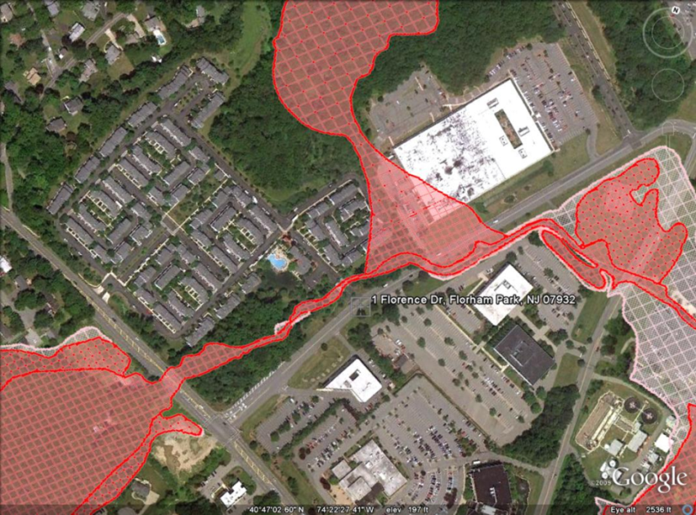
Google Earth & Mapping Capabilities
Google Earth Pro
Mapping Capabilities

Slide 22
Property Program Structure Example
RSUI 100%
$750M
Lancashire
35%
One Beacon 30%
Lloyds 20%
CNA
15%
$400M
ACE BDA
10%
Munich Re
30%
$200M
Arch 10%
Swiss Re 10%
RSUI
5%
HSB Re
37%
Axis
8%
ACE BDA
20%
$150M
Ironshore
10%
Aspen
4%
ACE 10%
CNA
2.5%
CV Starr
10%
Max Re
37.5%
$100M
Lloyds
7.5%
Lloyds
13. 5%
LMG 5%
Lloyds
20.67%
$75M
Lexington
33.33%
AWAC 15%
RSUI
10%
Lloyd’s
12.5%
LMG
7%
Mont
Re
10%
Ironshore
6.17%
$50M
Hannover Re
4%
Lloyds 2%
Westchester
20%
Lloyds
21.67%
$25M
Aspen 10%
Commonwealth
15%
DEDUCTIBLES

Slide 23
ZOOM® | Patent pending process that combines the science of predictive analytics and data mining with hands-on claims consulting and loss control engineering expertise
PULSE | Browser-based solution automated to all functions of your medical malpractice insurance policy allowing healthcare facilities and professionals to self-service accounts and bind medical malpractice coverage online
NOVUS | Browser-based tool with a completely traceable paperless process preserving data integrity, enhancing communication and keeping clients, insurers and broker in sync
RISK CONCIERGE | Web-based system that puts your data in one place so you can easily access and manage the effectiveness of your risk management program, analyze claims issues and structure your program
Executive Liability Capabilities
6
MARA
MARA | Multivariate Algorithm for Risk Analysis (MARA) evaluates approximately 4,000 metrics to determine and assess your company’s risk drivers
LiNK | Proprietary methodology enables you to accurately apportion the true cost of your premium among your property locations – all based on your chosen criteria
passion. innovation. accountability.

Slide 24
OUR
Products
EXECUTIVE LIABILITY Practice
The Executive Liability Practice (“ELP”) is a Beecher Carlson specialty practice made up of experienced and knowledgeable advisors/brokers solely dedicated to providing our clients with the advice needed to properly protect corporations an their directors and officers against unforeseen liability that arise from everyday corporate activities.
Focusing solely on executive liability exposures, including directors and officers liability, fiduciary liability, employment practices liability, professional liability, cyber insurance, crime insurance, kidnap/ransom & extortion insurance, and other financially-driven exposures, ELP advisors provide our clients with the most efficient and effective program structure and price backed by the strongest insurance companies worldwide.

Slide 25
Executive Liability Footprint
The Executive Liability Practice (ELP) is Beecher Carlson’s global management liability resource group.
  Cost neutral – assures “Best in Front” for clients
  Direct approach: Client-facing professionals are also your market-facing brokers
ELP Key Drivers:
  Product Expertise (D&O, E&O, EPL, Crime, Fiduciary, Transaction Liability and Special Crime)
  Industry Expertise (Healthcare, FI, Oil & Gas, Private Equity, Life Sciences, Retail, Distressed Co’s, etc.)
  Focused Resources – 23 dedicated resources to D&O & Executive Liability Insurance products
  Legal Leverage – 5 person Dedicated Claims Staff (all attorneys)
Boston
New York
Charlotte
Atlanta
Bermuda

Slide 26
Forward-Looking Analytics
Benchmarking Knowledge
Because we analyze approximately 4,000 data points — several times more than any other brokerage —you will know more about your risks than ever before and can compare and contrast your results with those of your peers. Using inputs from broad data sources, we provide an objective risk assessment score relative to comparable organizations and an estimation of the likelihood and severity of future securities class action, which forms the basis for adjusting both insurance limits and retentions.
Underwriting
Our analytical insight is highly persuasive, objectively demonstrating to carriers the facts supporting your unique risk profile. Knowledge of specific positive or negative risk factors means no surprises for senior management at underwriter meetings. And, it provides powerful intelligence to facilitate underwriter negotiations to ensure you the best terms, conditions and pricing.
Risk Modeling Opportunities
How often do you get the chance to play “what if?” with alternatives courses of action? With Beecher Carlson, you can model how a potential business decision may impact your future D&O risk profile, allowing you to simulate real world scenarios and outcomes.
Enterprise Risk Management Alignment
By identifying problem areas for a likely securities claim, you can more effectively mitigate and manage these exposures before they occur.

Slide 27

Claims Advocacy
When the worst happens in the boardroom, you need the expertise and experience of the industry’s most robust and well respected Claims Advocacy team. Beecher Carlson’s claims advocacy group has an emphasis on advocacy, not just claims management. Our claims advocates work with you, advising you on how to best mitigate trouble, rather than only stepping in after litigation is filed.
  We represent your interests before the carriers
  Our clients come to see us as an extension of their risk management function
  We have more high-profile, complex experience than any other broker
  We evaluate claims history to spot loss trends and offer guidance on reducing your exposure to future claims
  We use our experience handling your claims to look at opportunities to enhance coverage going forward.
  We furnish our clients with timely, relevant content that impacts their Executive Liability programs.

Slide 28
Claims Management Process
Blocking and Tackling
Managing Expenses
Initial reporting of claims
Analyzing reservation of rights
Analyzing correspondence that evidence their view of coverage
Consulting with you as to the most appropriate form of response
Drafting response letters for your review and approval
Gaining insurer approval of defense counsel & other supporting experts you may choose to engage in the defense of claims
Monitoring the claim activity until it matures into a resolution phase
Closely track and monitor insurer payments for you
Ensure that payments in accordance with the terms of the policy are made timely and accurately
Handle all defense expense issues with the insurers eliminating unnecessary distraction allowing you and your counsel to exclusively focus on defending counsel rates
Compliance with litigation guidelines/budgets
Recognition of exhaustion of policy retentions and appropriateness of deductions by insurers
Challenge insurer positions ensuring that you are optimizing your ability to obtain recoveries under the policy
Negotiating with Insurers
Risk Prevention, Mitigation and Education
We are on your side. In the event of material coverage issues or recalcitrant insurers, our objective is to bring the key decision-makers, both on the claims and underwriting side if necessary, to the table with the intent of supporting you in the resolution of claims. That support is usually, but not always, in the form of financial contributions; however, it is always our goal to have someone from the insurer with financial signing abilities available in the event of settlement discussions including mediation or arbitration proceedings.
We are prolific in the number of white papers we produce on recent case decisions of impact for our clients; changes in legal and regulatory requirements and claims trends. We can research issues for you and produce a position paper on a subject of concern or interest to you. One of our fundamental tenets is that an ounce of prevention is worth a pound of cure and so our mission is to reduce your dependence on the commercial insurance market in any area where you can produce greater results for your company, employees and shareholders by preventing a shock loss in the first place. Insurance, in our view, is no panacea for the reputational and other damage that ensues in the event of a major corporate governance and financial scandal.

Slide 29
Executive Liability Marketing Strategy
1
Historical Overview
2
Indemnification Provisions
3
Structural Analysis
4
Coverage Analysis
5
Carrier Analysis
6
Limits Analysis
7
Placement Strategy

Slide 30
Placement Strategy
7
Placement Strategy
1
The renewal strategy meeting
2
Underwriting meetings
3
Beecher Carlson meets with potential lead markets
4
Negotiations with underwriters and finalization of renewal program
5
Delivery of binders, all policies in correct form and renewal summary to client

Slide 31
ZOOM® | Patent pending process that combines the science of predictive analytics and data mining with hands-on claims consulting and loss control engineering expertise
PULSE | Browser-based solution automated to all functions of your medical malpractice insurance policy allowing healthcare facilities and professionals to self-service accounts and bind medical malpractice coverage online
NOVUS | Browser-based tool with a completely traceable paperless process preserving data integrity, enhancing communication and keeping clients, insurers and broker in sync
RISK CONCIERGE | Web-based system that puts your data in one place so you can easily access and manage the effectiveness of your risk management program, analyze claims issues and structure your program
Captive Capabilities
7
MARA
MARA | Multivariate Algorithm for Risk Analysis (MARA) evaluates approximately 4,000 metrics to determine and assess your company’s risk drivers
LiNK | Proprietary methodology enables you to accurately apportion the true cost of your premium among your property locations – all based on your chosen criteria
passion. innovation. accountability.

Slide 32
ACTIVE IN 10 DOMICILES
3rd LARGEST CAPTIVE MANAGER IN THE WORLD
2012 CAPTIVE MANAGER OF THE YEAR
CAPTIVE
Insurance
1 UNIQUE SOLUTION
FOR YOU
OVER 100
CAPTIVES

Slide 33
Captive Services
Three Phase Approach
1
Feasibility Study – Examine your current program and historical loss experience to outline specific components to operate an alternative program and assess potential cost savings and operational advantages.
2
Plan Design and Options – Design the most optimum alternative program for your business including actuarial loss projections, business plans, financial projections, application and licensing, fronting and reinsurance design and placement as well as claim handling design and placement.
3
Program Management – Combine our insurance knowledge, innovative problem-solving capabilities and exceptional experience in sophisticated program management to integrate your program on schedule and within your budget.

Slide 34
ZOOM® | Patent pending process that combines the science of predictive analytics and data mining with hands-on claims consulting and loss control engineering expertise
PULSE | Browser-based solution automated to all functions of your medical malpractice insurance policy allowing healthcare facilities and professionals to self-service accounts and bind medical malpractice coverage online
NOVUS | Browser-based tool with a completely traceable paperless process preserving data integrity, enhancing communication and keeping clients, insurers and broker in sync
RISK CONCIERGE | Web-based system that puts your data in one place so you can easily access and manage the effectiveness of your risk management program, analyze claims issues and structure your program
Environmental Capabilities
8
MARA
MARA | Multivariate Algorithm for Risk Analysis (MARA) evaluates approximately 4,000 metrics to determine and assess your company’s risk drivers
LiNK | Proprietary methodology enables you to accurately apportion the true cost of your premium among your property locations – all based on your chosen criteria
passion. innovation. accountability.

Slide 35
Environmental Services
Specialization in environmental risks
Deep understanding of environmental risks
Provide in-depth environmental risk reviews
  Risk exposure
  Risk prioritization
  Risk quantification
  Risk mapping
  Coverage review

Slide 36
ZOOM® | Patent pending process that combines the science of predictive analytics and data mining with hands-on claims consulting and loss control engineering expertise
PULSE | Browser-based solution automated to all functions of your medical malpractice insurance policy allowing healthcare facilities and professionals to self-service accounts and bind medical malpractice coverage online
NOVUS | Browser-based tool with a completely traceable paperless process preserving data integrity, enhancing communication and keeping clients, insurers and broker in sync
RISK CONCIERGE | Web-based system that puts your data in one place so you can easily access and manage the effectiveness of your risk management program, analyze claims issues and structure your program
Casualty Capabilities
3
MARA
MARA | Multivariate Algorithm for Risk Analysis (MARA) evaluates approximately 4,000 metrics to determine and assess your company’s risk drivers
LiNK | Proprietary methodology enables you to accurately apportion the true cost of your premium among your property locations – all based on your chosen criteria
passion. innovation. accountability.

Slide 37
Beecher Carlson Casualty Practice
The largest segment within Beecher Carlson
Approximately 70 staff members in the three major hubs:
  Atlanta, Woodland Hills, Nashville
  Captive management expertise with offices in Bermuda, Vermont and Hawaii
Nearly 40% of our Casualty staff is dedicated to claims, risk control and analytics because nearly 90% of your cost is based on your retained losses
  Our competitors: average 7-9% in claims and analytics staff compared to the Casualty staff
Manage more than 75 national accounts
Our staff includes senior industry pros supported by depth at all levels

Slide 38
ZOOM® | Patent pending process that combines the science of predictive analytics and data mining with hands-on claims consulting and loss control engineering expertise
PULSE | Browser-based solution automated to all functions of your medical malpractice insurance policy allowing healthcare facilities and professionals to self-service accounts and bind medical malpractice coverage online
NOVUS | Browser-based tool with a completely traceable paperless process preserving data integrity, enhancing communication and keeping clients, insurers and broker in sync
RISK CONCIERGE | Web-based system that puts your data in one place so you can easily access and manage the effectiveness of your risk management program, analyze claims issues and structure your program
Beecher Carlson’s
Casualty Practice
5
MARA
MARA | Multivariate Algorithm for Risk Analysis (MARA) evaluates approximately 4,000 metrics to determine and assess your company’s risk drivers
LiNK | Proprietary methodology enables you to accurately apportion the true cost of your premium among your property locations – all based on your chosen criteria
passion. innovation. accountability.

Slide 39
Retention Analysis
Complete review of available data
  Loss history
  Exposure history
  Large claim experience
  Supplement with industry sources as needed
Loss projections at a variety of retention options
  Consider client’s exposure and market conditions to determine viable retention options
Insurance Market Knowledge – how will the insurer respond?
Financial Analysis – how much can an insured afford to retain?

Slide 40
Integration of Analytics
Collateral/Reserve Analysis
  Estimate of outstanding losses at various evaluation points
  Estimate paid loss credits
  Negotiate with insurance company actuaries
  Identify trends and changes in risk profile which help drive lower reserve requirements

Slide 41
Cash Flow Analysis
Compile all expenditures and investment rates associated with each program option
  Loss projections, excess premium, claims handling, etc.
  Investment rate, tax rate, location rate
Compare total cost of each program option on a net present value (NPV) basis
  Discount all cash flows based on selected investment rate
  Perform sensitivity analysis to measure performance of programs under a range of scenarios

Slide 42
Focused Market Approach
Insurer | Year | Two Year Quote/Bind Ratio
ACE | 2012/2013 | 45%
Chartis | 2012/2013 | 36%
Arch | 2012/2013 | 73%
Zurich | 2012/2013 | 31%
Safety National | 2012/2013 | 75%
Because Beecher Carlson pre-underwrites our Casualty accounts, our Quote-to-Bind ratio is much higher than the industry average of 15% to 18%.

Slide 43
Our Process
Intense focus on reducing your claims cost – ZOOM®
Minimizing your insurance spend by optimizing your retention
Creating the most tax efficient structure
  Captive
  Self Insurance
  Assessments and Surcharges
Minimizing your insurance spend by optimizing your limits purchased
  Benchmarking
  Monte Carlo Simulation
World Class broking skills that deliver results
  Integration of analytics
  Focused market approach
  Cash Flow Analysis

Slide 44
Large Account Casualty Program
Loss Costs
70%
10%
Risk Transfer Costs
Claims Admin
8%
Taxes/Surcharges/
Assessments
6%
Collateral Costs/Broker Fees/Actuarial
6%
Where should the focus be?

Slide 45
ZOOM® | Patent pending process that combines the science of predictive analytics and data mining with hands-on claims consulting and loss control engineering expertise
PULSE | Browser-based solution automated to all functions of your medical malpractice insurance policy allowing healthcare facilities and professionals to self-service accounts and bind medical malpractice coverage online
NOVUS | Browser-based tool with a completely traceable paperless process preserving data integrity, enhancing communication and keeping clients, insurers and broker in sync
RISK CONCIERGE | Web-based system that puts your data in one place so you can easily access and manage the effectiveness of your risk management program, analyze claims issues and structure your program
Casualty Update
MARA
MARA | Multivariate Algorithm for Risk Analysis (MARA) evaluates approximately 4,000 metrics to determine and assess your company’s risk drivers
LiNK | Proprietary methodology enables you to accurately apportion the true cost of your premium among your property locations – all based on your chosen criteria
passion. innovation. accountability.

Slide 46
2013 Results Recap
P&C Combined Ratio: 2013: 96% 2012: 103%
  The majority of the success came from premium growth at 4.6% and loss adjustment expenses decreased by 5.5%.
  The insurers had a 15.5B net gain in 2013 vs 15.4B net loss in 2012.
2013 ROI for Insurers was10.3%, which is up 68% from 2012. This is the highest ROI since 2007.
WC Calendar Combined Ratio Improved for the first time since 2006:
  2011: 115% / 2012: 108% / 2013: 101% (Initially Projected at106%)
  Average medical cost per lost-time claim increased by 3% the third straight year showing this type of increase.
  Severity
Commercial Auto Calendar Combined: 2013: 105%

Slide 47
2013 View of 2014 WC Outlook
Combined Ratio continue to improve
Improvement in Underwriting Results
Premium growth for the third consecutive year
Claim frequency declined 2% by NCCI States – Mostly in lower back and multiple body party injuries – Arm and Shoulder claims up, but severity increased 2%.
Claim Severity Increases remained stable.

Slide 48
2013 View of 2014 WC Outlook
Slow Growth in employment, particularly in manufacturing and construction is impeding additional premium growth.
ACA and TRIA renewal continues uncertainty
Continuing low-interest rate environment threatens investment long-term.

Slide 49
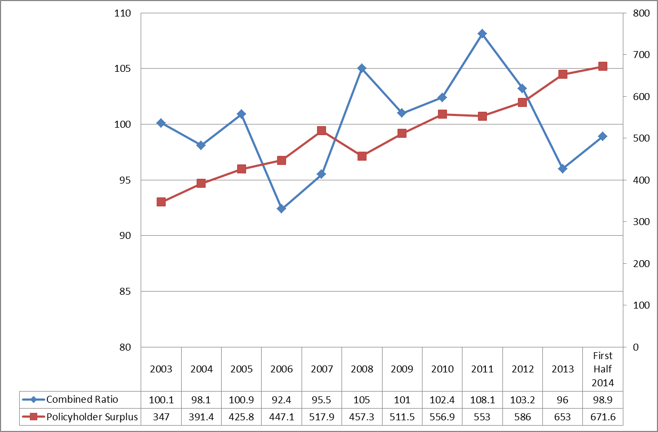
2014 2Q P&C Analysis
  P&C Combined Ratio through 2Q of 2014: 98.9%, which is up from 2012.
    The Combined Ratio is 5% better than the average over at 103.9%. But, it is estimated that the insurers will have to get to a combined ratio of 97% to earn their long-term average rate of return at 9%.
Policy Surplus remains at record levels at $671.6B. But, creating competition in the market place thus driving down the rates from what they need to be to get a higher rate of return.
Notes:
The Combined Ratio is 5% better than the average over 55 years at 103.9%. But, it is estimated that the insurers will have to get to a combined ratio of 97% to earn their long-term average rate of return at 9%. The interesting issue is most investors want to see at least 8% return, but ideally want more like 12% to make an investment.

Slide 50
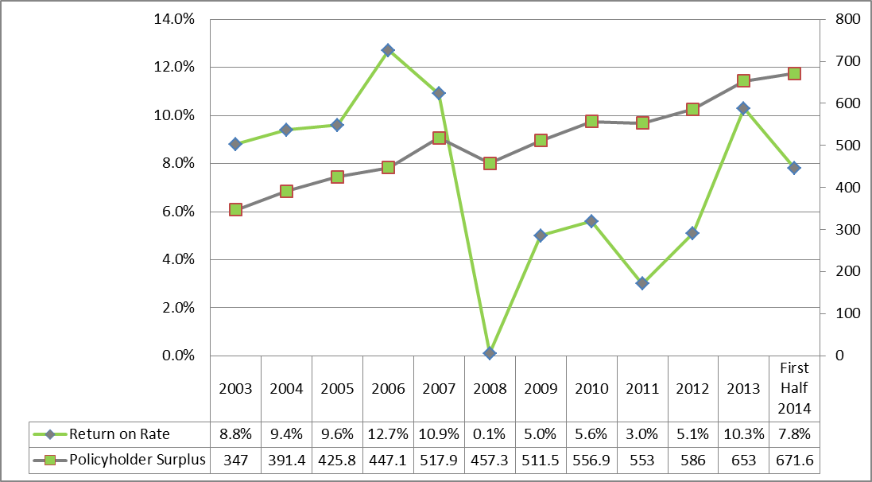
2014 2Q P&C Analysis
Rate on Return through 2Q 2014 declined to 7.8% from 8.1% in first half of 2013.

Slide 51
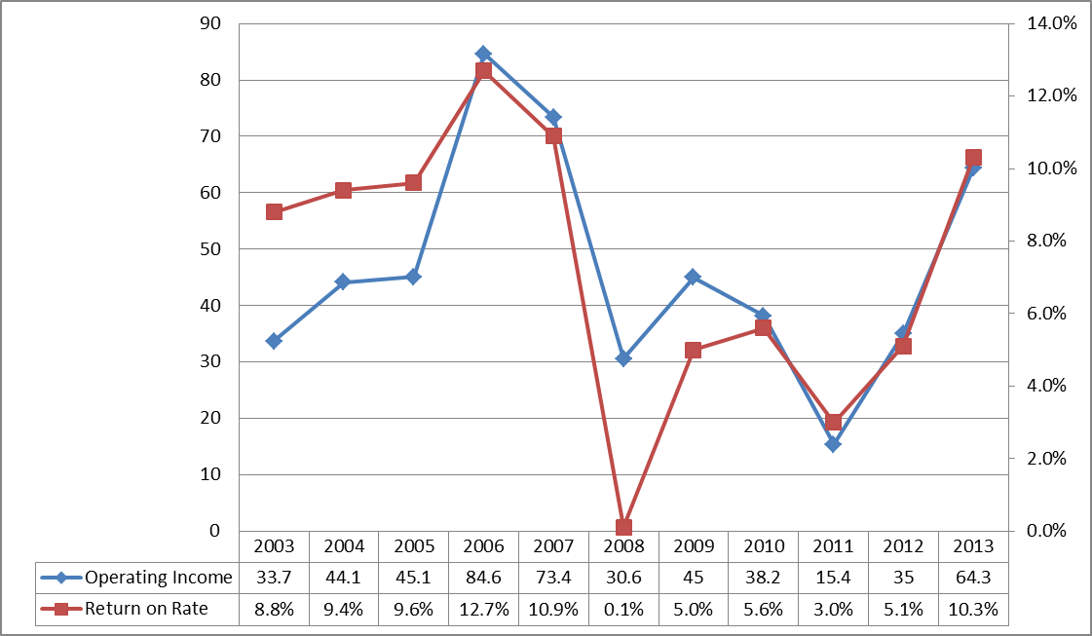
2014 2Q P&C Analysis
2014 2Q Pre-Tax Operating Income Decreased 7% to 23.9B from 25.8B
  Driven by declines in net gains on underwriting and investment income.
    Underwriting gains dropped 87% through to .3 B from 2.2 B in second quarter 2013
    Investment income dropped by 1.3%

Slide 52
S&P Profitability Analysis
ROE
Volatility is endemic to stock markets—and may be increasing—but there is no persistent downward trend over long periods of time
Fed Raises Rate
2014:H1 7.7%
Tech Bubble Implosion
Energy Crisis
Financial Crisis
*Through Oct. 12, 2014.
Source: NYU Stern School of Business: http://pages.stern.nyu.edu/~adamodar/New_Home_Page/datafile/histretSP.html Ins. Info. Inst.

Slide 53
Historical ROE Analysis
(Percent)
P/C Profitability Is Both by
Cyclicality and Ordinary Volatility
Katrina, Rita, Wilma
Low CATs
Sept. 11
Hugo
Lowest CAT Losses in
15 Years
4 Hurricanes
Sandy
Andrew
Record Tornado Losses
Northridge
Financial Crisis*
* Excludes Mortgage & Financial Guarantee in 2008 – 2014. 2014 figure is through H1:2014.
Sources: ISO, Fortune; Insurance Information Institute.

Slide 54
2014 Outlook
2014 Elections: 6,000 seats up for election on November 4, 2014. Only 8 states will not be involved in elections within the state and/or house.
Only 11 States have elected insurance regulators.
  36% of the states are having races in November: CA, GA, KS, and OK. AK and DC are also anticipate new commissioners due to recent departures.

Slide 55
Workers Compensation Outlook
  States to watch:
  AL: Legislation to allow injured worker to decide pharmacy to fill Rx.
  AK – Hearing about high medical cost
  AZ – Bill limiting physician dispensing and IW right to select pharmacy
  CO- Potential change to allow employee choice of physician and increased benefits with willful conduct against employer. Revision of e-mod within 30 days of claim closure or settlement through subrogation vs updating at normal valuation date.
Notes:
MT, NV, ND, and TX are the remaining 11 states.

Slide 56
Workers Compensation Outlook
  States to watch:
  CT : Pursuing mental trauma for employees witnessing death a work-related event and adoption of Medicare-based hospital fee schedule.
  FL: Two Supreme Court Cases:
    Westphal Case: The court is deciding whether a worker who has not reached MMI and exhausted their 104 weeks of TTD is eligible for permanent disability while they are still improving.
    Morales Case: The court ask to rule on whether an insurer that has paid a claimant lump sum benefit should still be liability for additional claim under the EL section of the policy, voiding FL’s exclusive remedy provision.
  ID: Senate Bill could create that cancers experienced by long-term firefighters would be compensable.
  HI: Update Medical Fee Schedule every year and capping of physician-dispensing of repackaged drugs.
Notes:
MT, NV, ND, and TX are the remaining 11 states.

Slide 57
Workers Compensation Outlook
  States to watch:
  IL : Illinois Chamber of Commerce seeking legislative changes to get liberal court rulings under control with respects to narrower definition of injury causation.
  MT: Review of possible privatization of MT State Fund
  NH: Initiative to increase weekly wage benefits and medical cost containment reform.
  NJ: Cost of Living Benefit increase for Workers Compensation Permanent Total Disability Injuries
  NM: Employers pushing to prohibit benefits if injured worker was willfully under influence of alcohol or illegal drugs.
  SC: Provided Mental Benefits to officers involved in use of deadly force
  TX: Examining Opioid Abuse and misclassification of IC
  VT: Misclassification of IC
  VA: Medical Cost Control and Medicare backed fee schedule
  WA: Measure to allow injured workers to settle their case with lump sum vs lifetime disability benefits.
Notes:
MT, NV, ND, and TX are the remaining 11 states.

Slide 58
ACA Impact
Cons:
  Scheduling of Appointments may be harder with medical facilities due to the increase of patient loads due to the 1M additional patients anticipated to enter the healthcare system.
  Use of PA, Nurse Practioners, and telemedicine may assist with the longer wait, but we find this treatment is not always consistent with primary physician.
Notes:
MT, NV, ND, and TX are the remaining 11 states.

Slide 59
ACA Impact
Pros:
  Injured Workers who did not previously have health benefits may not seek treatment through WC.
  Potentially, people may seek treatment more regularly and generally be healthier so they don’t have as long of a healing time when injured at work.
Notes:
MT, NV, ND, and TX are the remaining 11 states.

Slide 60
Surgical Cost Group Health vs WC
Most states the cost of the same surgical procedure is 43% higher in WC vs a group health plan. Average between ($2,000 and $4,000 per surgery)
The states with the highest variance have no fee schedule or a % of charge-based fee schedule (NJ, NC, IA, IL, LA, FL, & VA)
Notes:
MT, NV, ND, and TX are the remaining 11 states.

Slide 61
RX Update
Prescription cost per claim continue to grow and are a significant driver in medical cost increasing.
Physician-dispensed drugs continue to increase.
Narcotics account for 25%of drug cost
45% of Narcotics cost are for drugs that contain oxycodone HCL.
Notes:
MT, NV, ND, and TX are the remaining 11 states.

Slide 62
Lost Time Metric Update
Frequency decreased in 2012 by 5% and 2013 by 2%.
Duration of TTD benefits is down to 140 days from 143 days.
  Men have 13% higher benefit duration than women.
  Duration trending typically tracks with the national unemployment rate.
Construction and Manufacturing Industries are the largest decreases, but these are the heaviest hit industries by the economic factors.
Notes:
MT, NV, ND, and TX are the remaining 11 states.

Slide 63
ZOOM® | Patent pending process that combines the science of predictive analytics and data mining with hands-on claims consulting and loss control engineering expertise
PULSE | Browser-based solution automated to all functions of your medical malpractice insurance policy allowing healthcare facilities and professionals to self-service accounts and bind medical malpractice coverage online
NOVUS | Browser-based tool with a completely traceable paperless process preserving data integrity, enhancing communication and keeping clients, insurers and broker in sync
RISK CONCIERGE | Web-based system that puts your data in one place so you can easily access and manage the effectiveness of your risk management program, analyze claims issues and structure your program
ZOOM®
6
MARA
MARA | Multivariate Algorithm for Risk Analysis (MARA) evaluates approximately 4,000 metrics to determine and assess your company’s risk drivers
LiNK | Proprietary methodology enables you to accurately apportion the true cost of your premium among your property locations – all based on your chosen criteria
passion. innovation. accountability.

Slide 64
OUR Integrated Approach
Traditional Broker
Beecher Carlson – ZOOM® Process
Claim Advocacy
Claim Reviews
Claim Audits
Pre-engagement Analytics
Scorecard
Trend Analysis
Diagnosis and Focus
Strategic Claim Management
TPA Alignment
Strategic Claim Reviews
Loss Prevention
Lagging indicators,
reactive service
Leading indicators, Pro-active strategic service focused on the right actions to reduce claims costs

Slide 65



What is the ZOOM® Process?
SCORECARDS &
GOAL TRACKING
HISTORICAL CLAIMS
CAUSE & EFFECT /
ROOT CAUSE
JOINT STEERING COMMITTEE
  AND STEWARDSHIP / ACCOUNTABILITY
SOLUTION
CURRENT CLAIMS
CLAIMS / PREDICTIVE MODELS
PROCESS SOLUTIONS
SOLUTION
PROSPECTIVE CLAIMS
STRATEGIC CLAIM
FILE MANAGEMENT
SOLUTION

Slide 66
What is the ZOOM® Process?
10%
HISTORICAL CLAIMS
$26,000,000
________________________
% of Savings Estimate
Outstanding Liability $____________
Projected Ultimate $____________
Total Outstanding Liability $____________
CURRENT CLAIMS
$6,000,000
$32,000,000
$2,600,000
PROSPECTIVE CLAIMS
________________________
Estimate Financial Savings
Average Outstanding Liability Multiple is 3 times Projected Ultimate
Key Locations: CT, IL, TX, CA, IN, GA, and IA

Slide 67
Better Results: Provided by Beecher Carlson
BEECHER’S
ZOOM® PROCESS GETS BETTER RESULTS
14% Average Reduction on Projected Ultimate Incurred
29% Average Reduction on Reserve Liabilities
31% Average Reduction on existing collateral
We have mitigated our client claim cost by $215,041,280 in the last two years.
Insurers will accelerate a reduction in collateral for ZOOM® clients
Insurers will lower deductible / excess workers compensation premiums on ZOOM® clients
With ZOOM® analytics, we present a stronger marketing submission
Notes:
Focus on overall result to date for our ZOOM clients.

Slide 68
ZOOM® Analytics
Baseline Assessment
Data Run by 32 Key WC Performance Indicators (KPI’s)
Establish Baseline Outcomes
Provide Suggested Goals and Objectives by Policy Year

Slide 69
ZOOM® Analytics
Sample - Adjuster Indemnity Closure

Slide 70
ZOOM® Analytics
Sample Indemnity CAT Scan

Slide 71
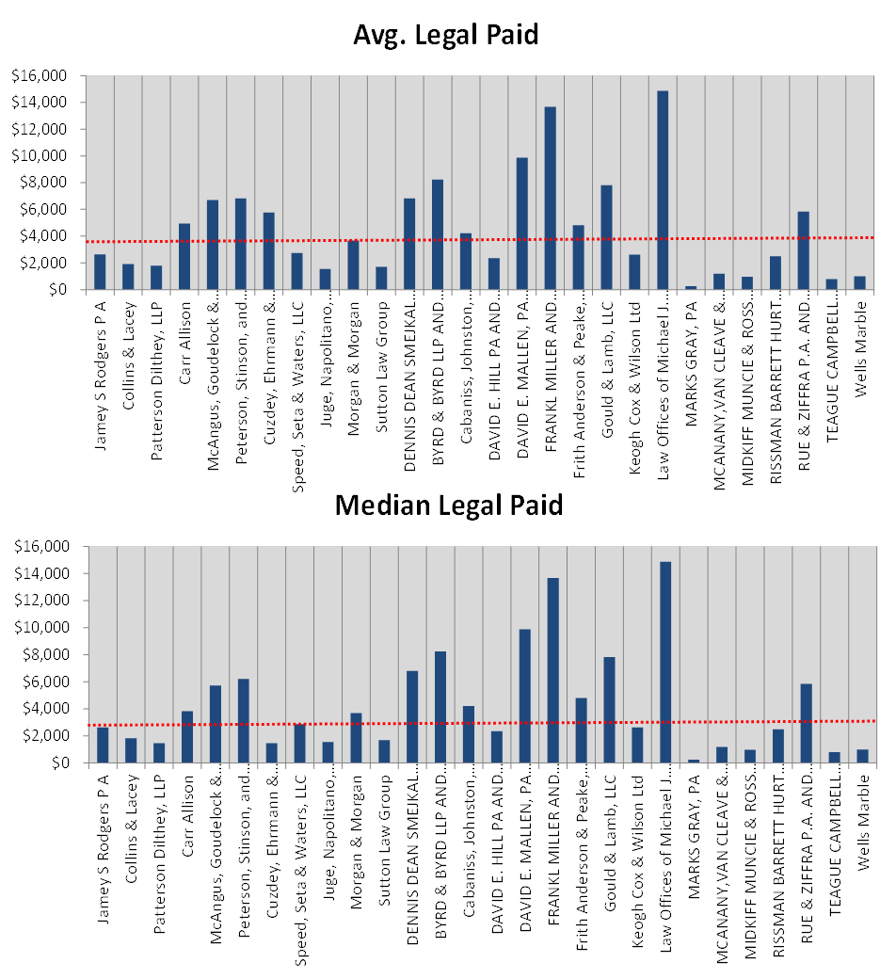
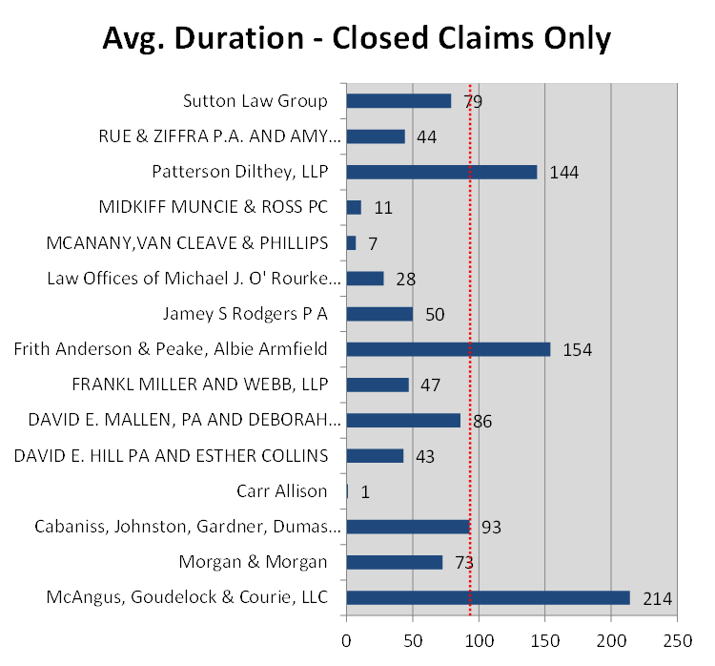


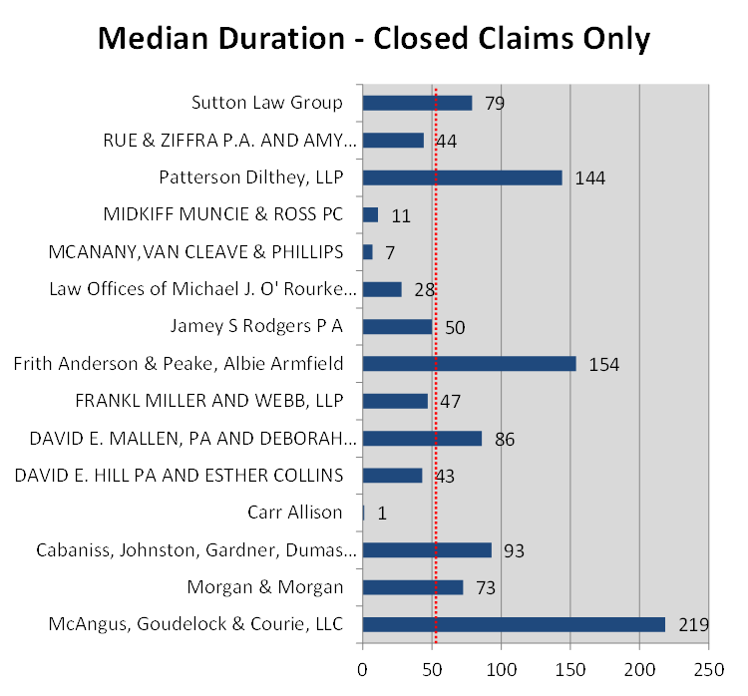
ZOOM® Analytics
Sample Litigation Analysis

Slide 72
ZOOM® Analytics
Claims Models- 18 Month Older Low Paid%

Slide 73
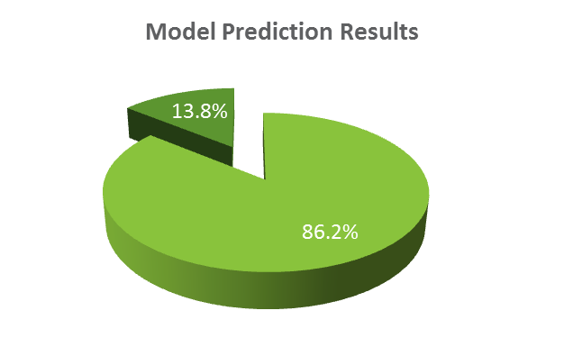
ZOOM® Analytics : Early Warning Model
Client historical data is obtained and prepared for analysis . Predictor attributes not known at claim inception are removed.
Model Prediction Results
Correct Prediction
Incorrect Prediction
Overall Sample Information | Actual Event: Claims Closes >$15,000
 | No | Yes
# of Claims | 5,312 | 651
Mean Ult. Incurred | $948 | $53,937
Sum of Ult. Incurred | $5,035,776 | $35,112,720
% of Claims | 89.1% | 10.9%
% of Cost | 12.5% | 87.5%
Only closed claims NOT used in model development are included in model validation (30% of Original Dataset).
Results with a cut-point of .18
Claim Closes > $15,000
 |  | Predicted
 |  | FALSE | TRUE | TOTAL
Actual | FALSE | 1,449 | 173 | 1,622
 | TRUE | 76 | 104 | 180
 | TOTAL | 1,525 | 277 | 1,802
Overall Model Accuracy is 86.2%
Dataset is split into two parts
(70% and 30%)
using a random number generator
Predictive Model Developed Using Information on a Subset of the Historical Closed Claims (70% of Original Dataset).

Slide 74
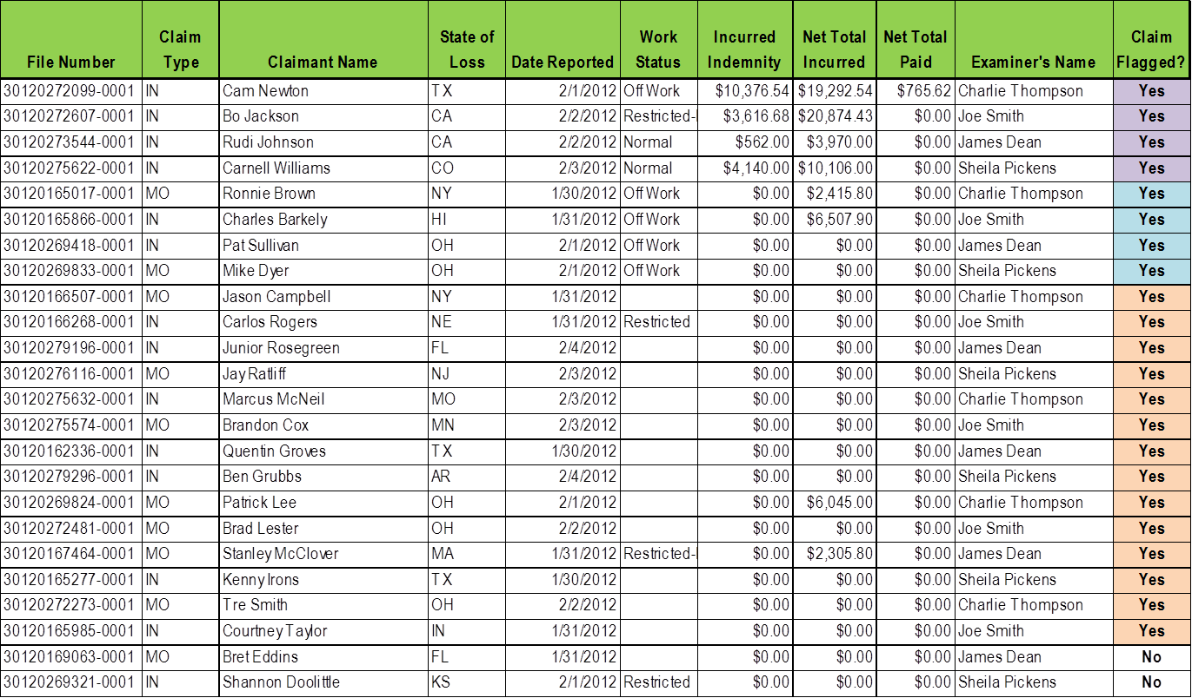
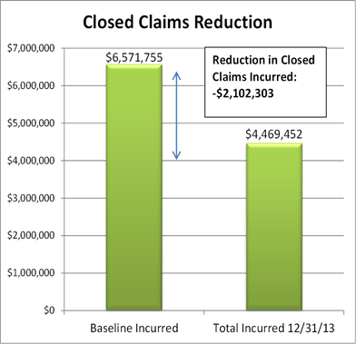
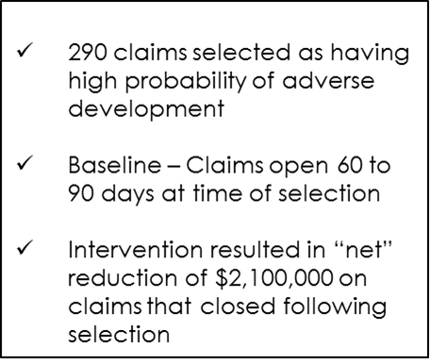
ZOOM® Analytics
Claims Models
Risk Factor Claim Selection
  Litigation
  Surgery
  Narcotics
  Comorbidities
  Repeat Claimant

Slide 75

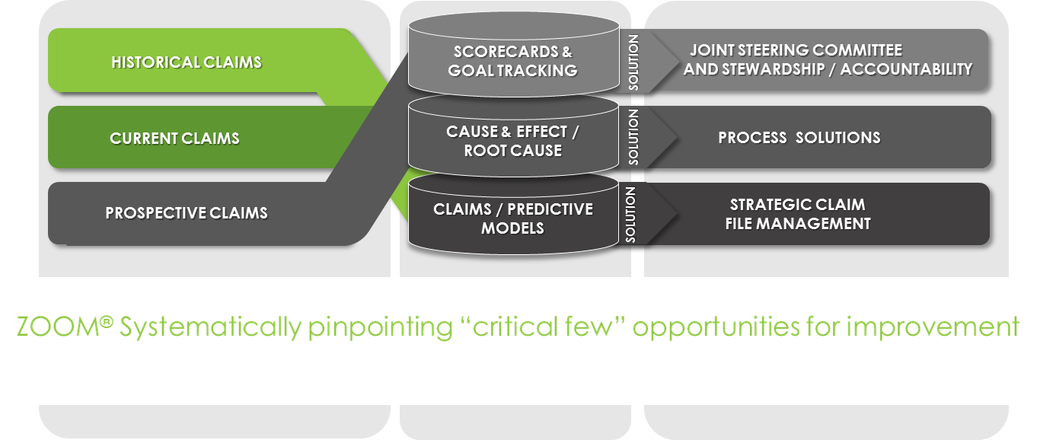
ZOOM® | Patent pending process that combines the science of predictive analytics and data mining with hands-on claims consulting and loss control engineering expertise
PULSE | Browser-based solution automated to all functions of your medical malpractice insurance policy allowing healthcare facilities and professionals to self-service accounts and bind medical malpractice coverage online
NOVUS | Browser-based tool with a completely traceable paperless process preserving data integrity, enhancing communication and keeping clients, insurers and broker in sync
RISK CONCIERGE | Web-based system that puts your data in one place so you can easily access and manage the effectiveness of your risk management program, analyze claims issues and structure your program
ZOOM® Solutions
MARA
MARA | Multivariate Algorithm for Risk Analysis (MARA) evaluates approximately 4,000 metrics to determine and assess your company’s risk drivers
LiNK | Proprietary methodology enables you to accurately apportion the true cost of your premium among your property locations – all based on your chosen criteria
passion. innovation. accountability.

Slide 76
ZOOM® Solutions
Operational Assessment / Process Solutions
Assess the current practical levels of performance of the critical processes
  Conduct a review of current policies and procedures
  Survey/interview client teams to obtain understanding of current practices
  Assess Vendors – TPA, Medical providers, Legal, nurse case management, medical bill review, surveillance
Produce a score relating to critical processes to provide insight into improvement opportunities
Provide gap analysis, recommendations, and timeline for implementation of improvement tactics/action teams

Slide 77
ZOOM® Solutions
Strategic Claim File Management
Collaborate with TPA/ Carriers/Clients
on action plans for selected files
Focus Reviews
  Reserves
  Disability
  Medical Prognosis / MMI
  Adjusting Office Closing Analysis
  Repeat Claimant Files
Identify and manage the appropriate closure time frame for maximum financial outcome.

Slide 78
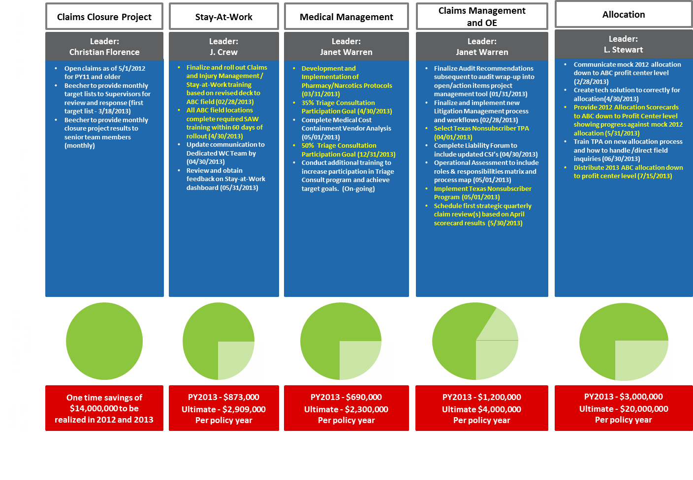
ZOOM® Solutions
Joint Steering Committee and Accountability
Implementation and Management
Quarterly scorecard reporting to track
and trend process
Quarterly Joint Steering Committee
meetings:
Client
TPA
Beecher Carlson
Floaters (i.e. Safety, PBM, etc)
Customized reporting on goals
established outside scorecard format
Data and Claim Partner Management
Continued cause and event analysis
to identify emerging trends
  Team problem solving/solution implementation/execution

Slide 79
Policy Year 2014 ZOOM® Scorecard: 7 Month Results
2014 off to a great start
  Avg. cost per claim -26% and median cost per claim -13%
  Lower % of ind. claims helping support the favorable severity trend
  Ind. closing % outpacing the prior year leaving fewer open claims developing
  Losses as a rate of payroll -20%; excellent result through 8 months

Slide 80
Policy Year 2013 ZOOM ® Scorecard: 20 Month Results
Total incurred trend outpacing the projected trend through 20 months
Median severity trend only +5%
Increase in the % of ind. claims responsible for 26% of the severity increase
  If PY13 had a 28% ind. rate, severity trend would be +25%
  Ind. closures lagging in 2013: if PY13 had 46% closure rate there’d be 214 closed ind. claims
  Large losses (top 10) responsible for 21% of the severity increase in 2013

Slide 81
ZOOM® | Patent pending process that combines the science of predictive analytics and data mining with hands-on claims consulting and loss control engineering expertise
PULSE | Browser-based solution automated to all functions of your medical malpractice insurance policy allowing healthcare facilities and professionals to self-service accounts and bind medical malpractice coverage online
NOVUS | Browser-based tool with a completely traceable paperless process preserving data integrity, enhancing communication and keeping clients, insurers and broker in sync
RISK CONCIERGE | Web-based system that puts your data in one place so you can easily access and manage the effectiveness of your risk management program, analyze claims issues and structure your program
ZOOM® Financial Case Studies
MARA
MARA | Multivariate Algorithm for Risk Analysis (MARA) evaluates approximately 4,000 metrics to determine and assess your company’s risk drivers
LiNK | Proprietary methodology enables you to accurately apportion the true cost of your premium among your property locations – all based on your chosen criteria
passion. innovation. accountability.

Slide 82
BETTER RESULTS: Provided by Beecher Carlson
** 2009 Actuarial Report for policy terms 2004 to 2009. 2010-2013 are initial projection provided within that year’s actuarial report (i.e. 2010 is 2010 report)
Ultimate Incurred Reduction: <14%>
Outstanding Liability Reduction : <73%>
LOC Reduction: <51%>

Slide 83
BETTER RESULTS: Provided by Beecher Carlson
** 2009 Actuarial Report for policy terms 2004 to 2009. 2010-2013 are initial projection provided within that year’s actuarial report (i.e. 2010 is 2010 report)

Slide 84
BETTER RESULTS: Provided by Beecher Carlson
** 2009 Actuarial Report for policy terms 2004 to 2009. 2010-2013 are initial projection provided within that year’s actuarial report (i.e. 2010 is 2010 report)

Slide 85
BETTER RESULTS: Provided by Beecher Carlson
2009 to 2014: <22%> Reduction
2009 to 2014: <41%> Reduction
Payroll
2009: $739,857,000
2014: $984,912,000

