Slide 1

D&O and Cyber Threats
Casualty Risk
SRMC Benchmarking
Evidence-Based Risk Management
Andrew D. Banasiewicz, Ph.D.

Slide 2
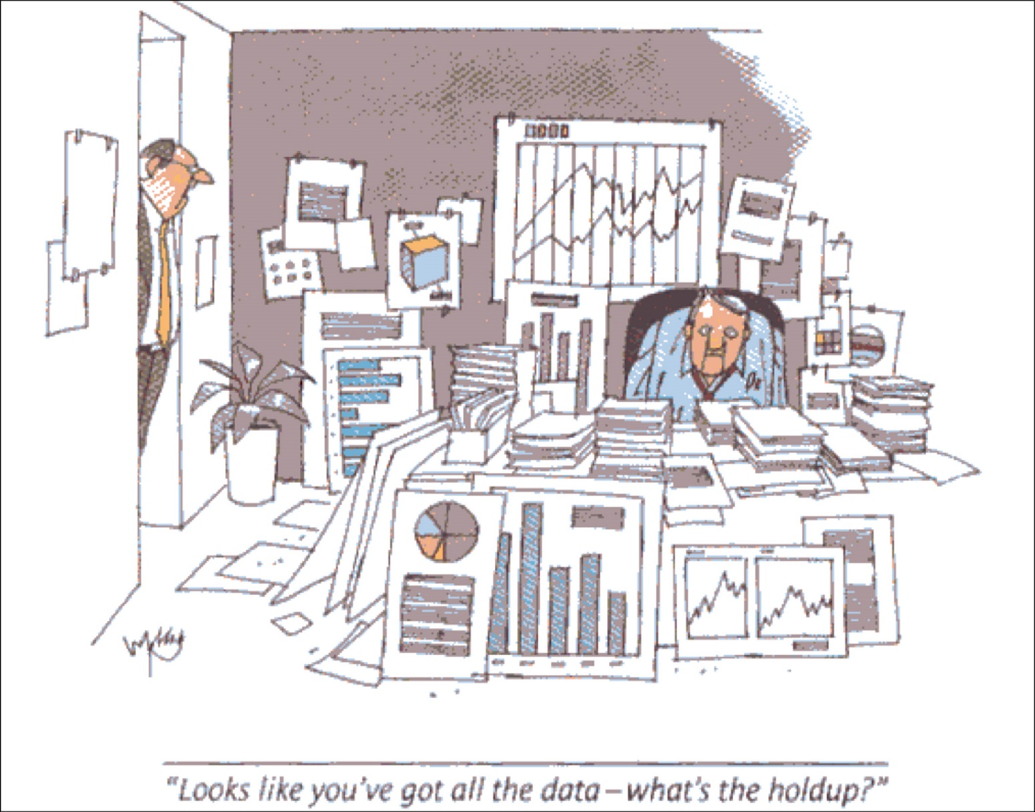
Drowning in Data and Still Guessing…
Copyright Andrew D Banasiewicz. All rights reserved.

Slide 3
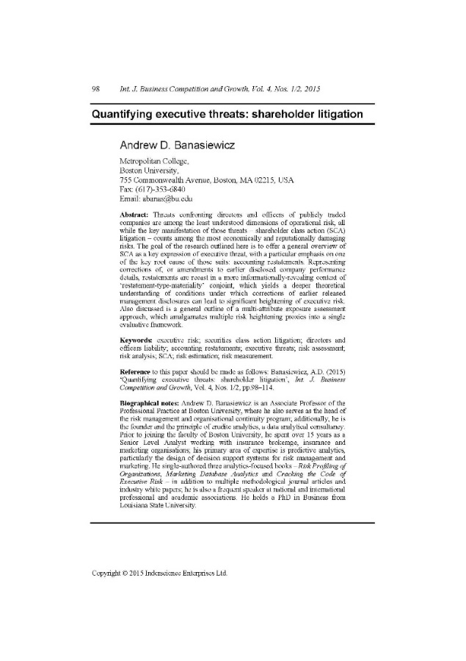

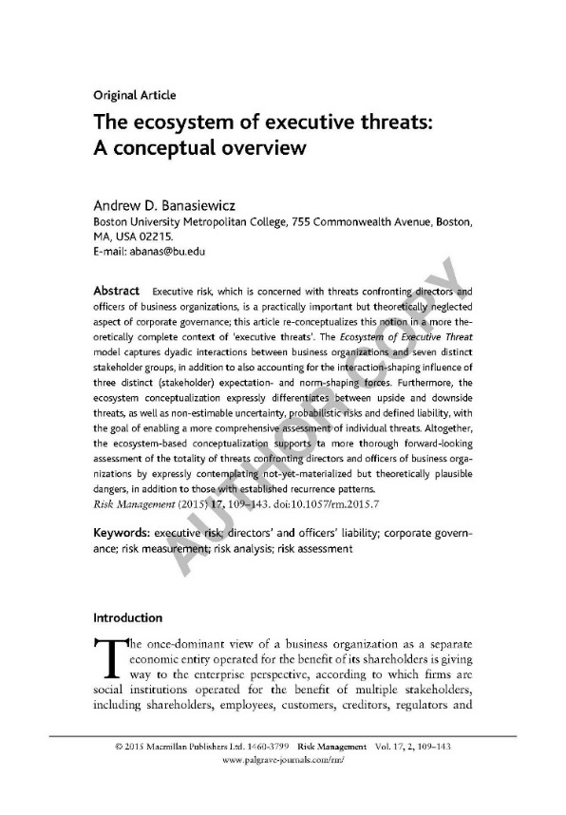
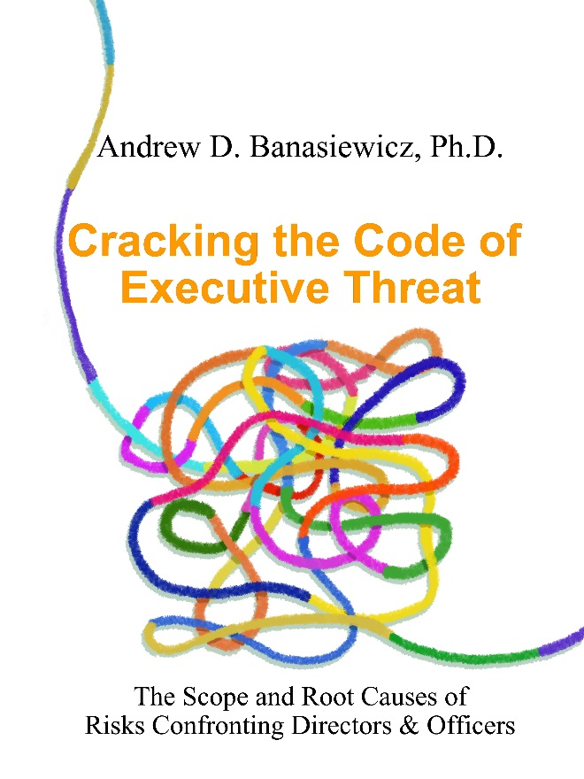
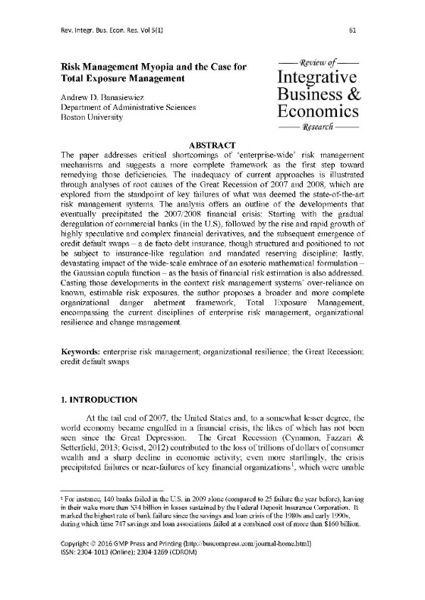

A Word About Myself: A Combination of Practice & Research
Two decades of industry, research & predictive analytical experience
Four books, numerous articles and white papers
Numerous domestic and international conference presentations & keynotes, including RIMS and Global Risk Forum
Copyright Andrew D Banasiewicz. All rights reserved.

Slide 4
Erudite Analytics Offerings
Evidence Based Risk Management
Ad Hoc Solutions
Explore | Predict
Casualty Risk
WC | GL
Executive Risk
D&O | Cyber
Structured Solutions
Owned event datasets
Proprietary algorithms
Custom Analyses
Benchmarking
On-demand studies
Copyright Andrew D Banasiewicz. All rights reserved.

Slide 5
D&O | Cyber threats
Structured Solutions

Slide 6
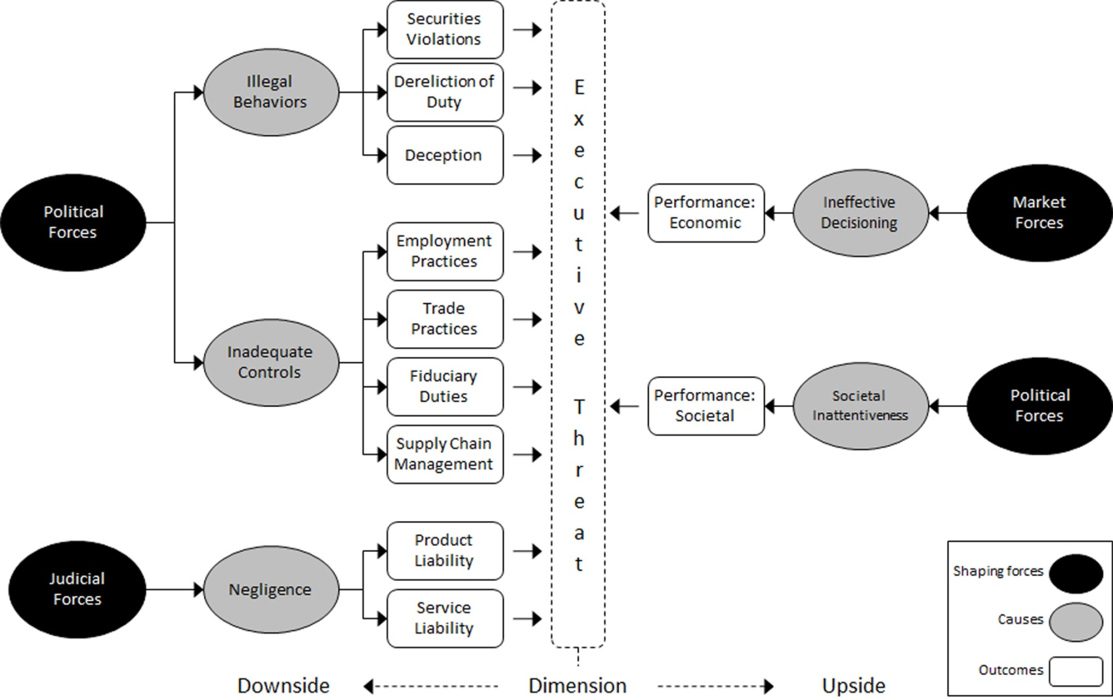
Conceptual Backdrop: The Meta Model of Executive Risk
Copyright Andrew D Banasiewicz. All rights reserved.

Slide 7
Focusing on Securities Class Actions (SCA):
Data & Analyses
Input: Cause
Key Events: IPO; M&A
Restatements
Accounting Accruals
Key Ratios from
Balance Sheet &
Income Statement
Downside Stock Price Volatility
End Result
Firmographics
Data Amalgamation, Processing & Analyses
Company-Specific Likelihood & Severity Estimates
Input: Outcome
SCA Filings & Settlements
Copyright Andrew D Banasiewicz. All rights reserved.

Slide 8
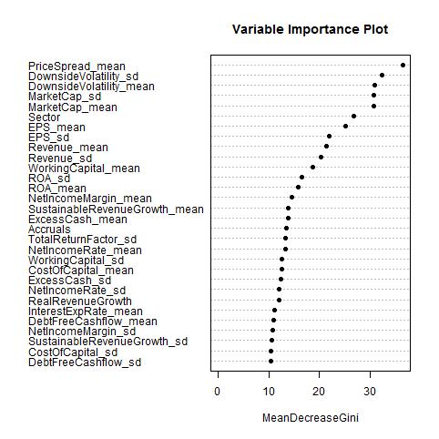
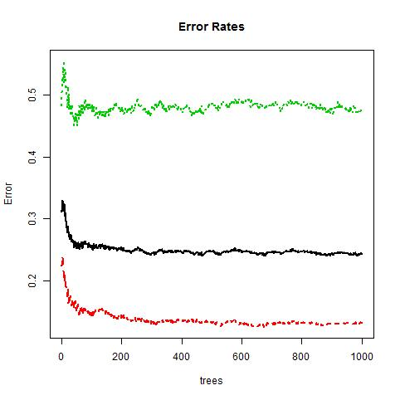
SCA Likelihood Estimation
Input data sample:
441 verified public co SCA filings (last 3 years);
A sample of 912 of non-SCA public companies;
All available firmographic, financial & stock movement data
SCA
Overall avg.
No SCA
Regression Trees
Copyright Andrew D Banasiewicz. All rights reserved.

Slide 9
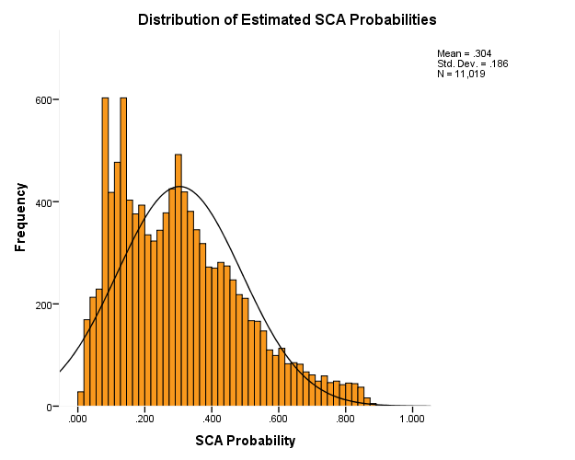
SCA Likelihood Scoring: All Public US Companies
Each public US company was scored with the earlier-derived several hundred regression trees, the results of which were averaged to arrive at company-specific SCA likelihood, leading to the aggregate distribution (left) and classificatory typology (right).
Aggregate SCA Score Distribution
Mean = .304
Std. Dev. = .186
N = 11,019
Classificatory Typology
Objective assessment of their own unique exposure enables companies to make more rational risk transfer (i.e., D&O coverage) choices – for instance, Low SCA likelihood suggests higher SIR
Copyright Andrew D Banasiewicz. All rights reserved.

Slide 10
SCA Severity Estimation – Multi-Attribute Indexing
Key Highlights:
Company-specific estimation;
Based on hand-collected sample of 460 individual, verified SCA settlements;
Explicitly takes into accounts industry sector differences;
Explicitly takes into account regulatory (PSLRA of ‘96; SOX) and judicial (US Supreme Court) acts and rulings;
Adjusts for market cap differences;
Nets out the ‘expected’ levels of stock’s downside variability (loss causation);
Non-linear market cap vs. exposure estimation (e.g., 3x market cap does not automatically mean 3x higher loss);
Expected loss expressed as pseudo credible intervals;
Estimated Loss Ranges for US Exchanges Traded Companies
Copyright Andrew D Banasiewicz. All rights reserved.

Slide 11
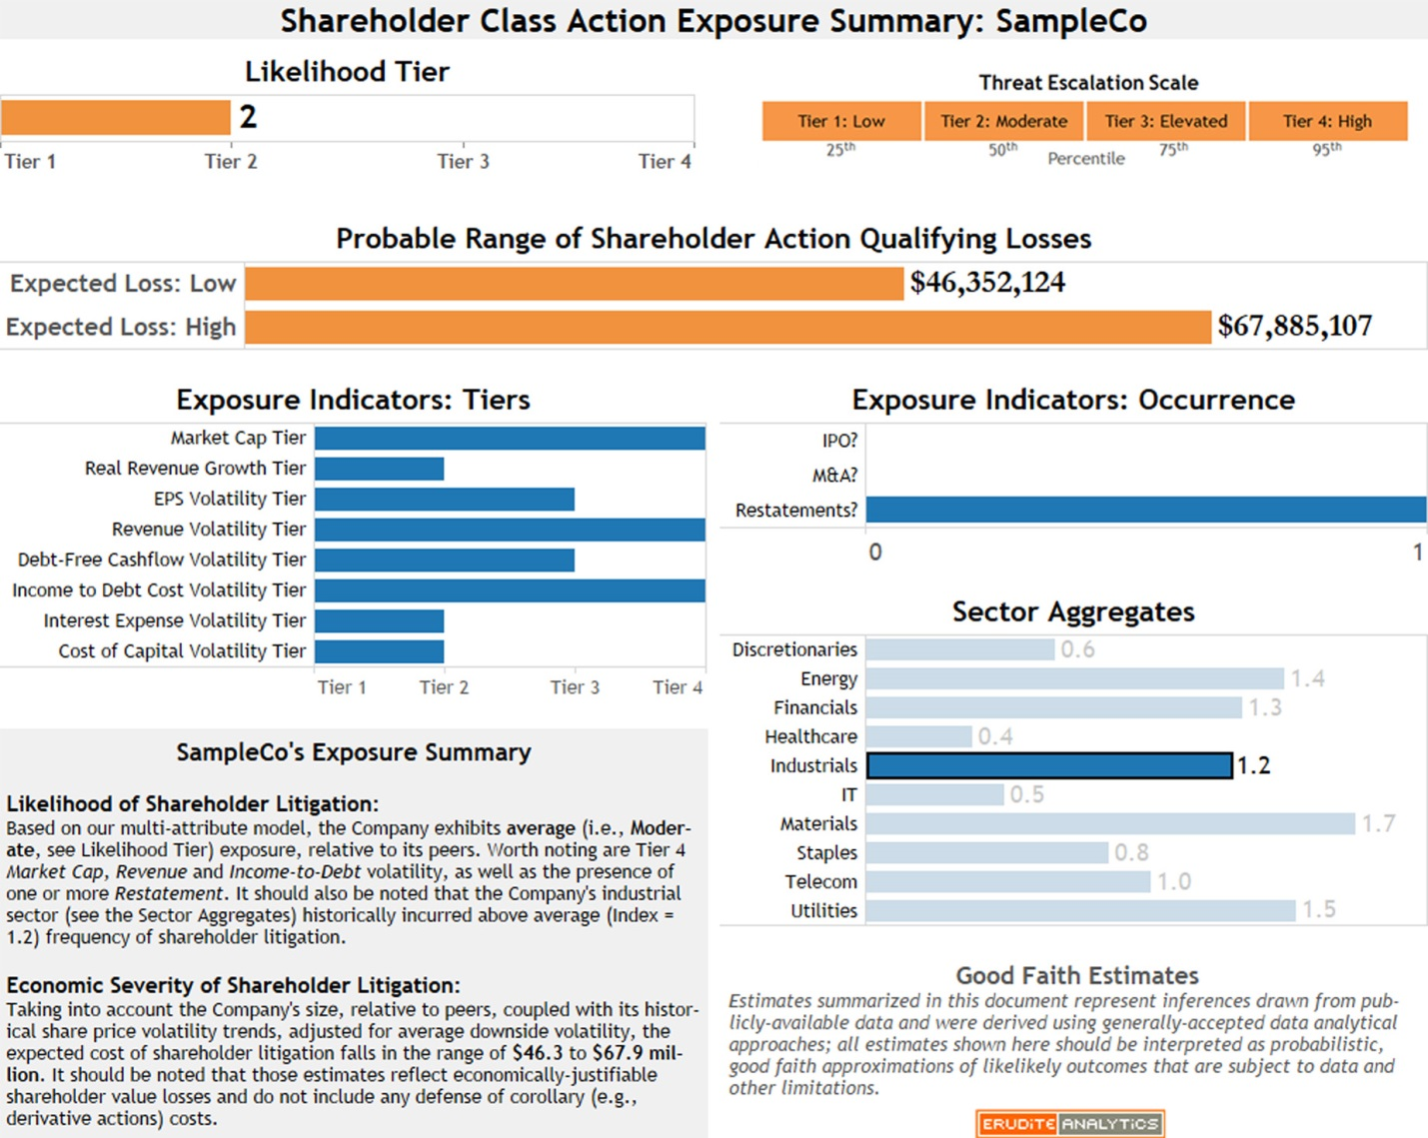
Company-Specific Exposure Reports: Focusing on What Matters
Copyright Andrew D Banasiewicz. All rights reserved.

Slide 12
Casualty risks: wc | gl
Structured Solutions

Slide 13
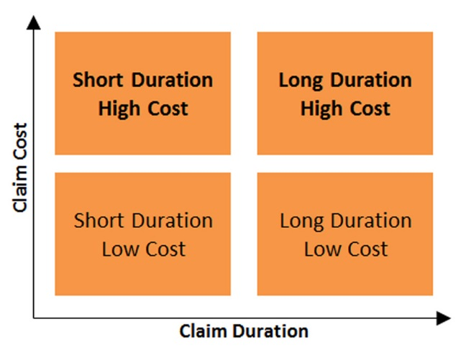
Meeting Obligations in Fiscally Sound Manner
Typically, casualty claim management is highly reactive, as claim handlers take action in response to claim development
The available data makes it possible for claim handlers to act proactively, which will result in lower claim costs
Organizations have legal duties when casualty accidents – WC/GL – arise, but
organizations also need to manage their expenses responsibly.
Making sound use of the available data, organizations can accomplish both objectives.
Copyright Andrew D Banasiewicz. All rights reserved.

Slide 14
Managing the Total Cost of Casualty Risk
Loss Prevention
Claim Management
Risk Financing
Newly-Open Claims
(1 year or less since opening)
Residual Claims
(1+ years since opening)
Incidence Analytics
Which individual claims are likely to develop adversely?
How are aggregate claim carrying costs trending?
Financial Analytics
What factors inflate short-term claim costs?
What factors inflate long- term claim costs?
Predictive Claim Scoring
Claim Carrying Cost Index
Period Scorecard & Cumulative Knowledge Base
Copyright Andrew D Banasiewicz. All rights reserved.

Slide 15
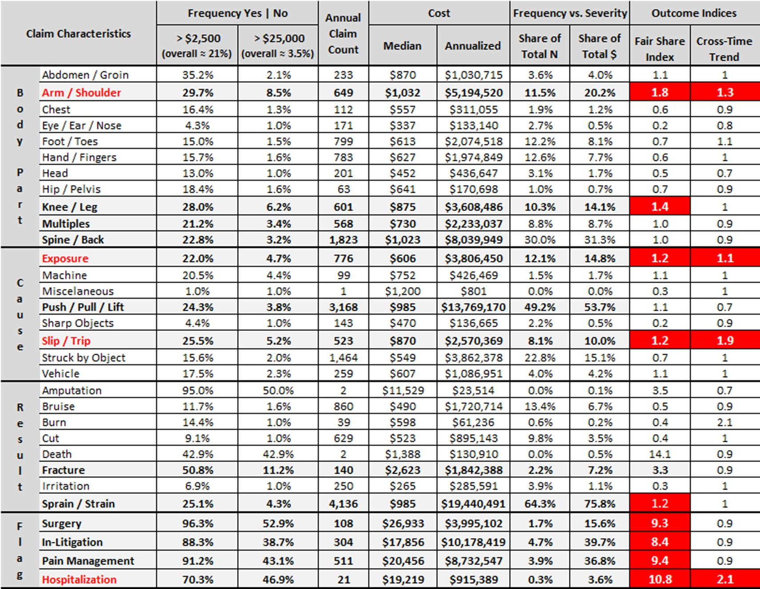
Predictive Claim Scoring
--For Illustrative Purposes Only--
An analytic method for estimating the expected future cost of individual workers comp claims, and for identifying the most promising risk reduction actions and strategies.
Copyright Andrew D Banasiewicz. All rights reserved.

Slide 16
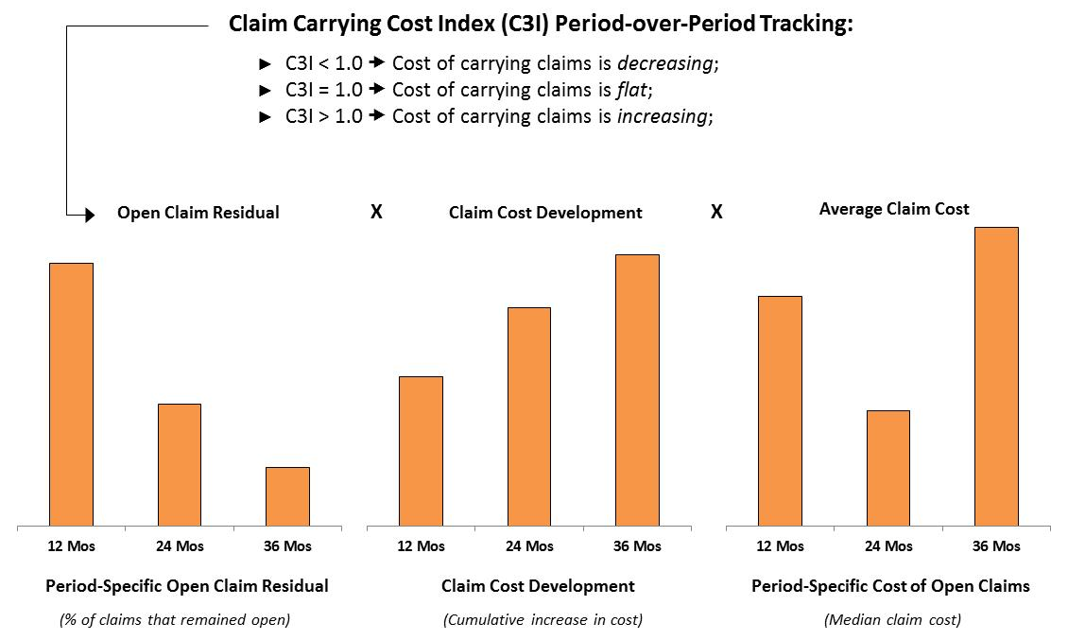
Claim Carrying Cost Index (C3I)
C3I enables claim managers to make meaningful cross-time assessment of cost development trends and root causes of the ever-changing (i.e., hard to compare) mix of longer duration (1 year+ since inception) claims.
Copyright Andrew D Banasiewicz. All rights reserved.

Slide 17
SRMC benchmarking
Ad Hoc Solutions

Slide 18
Imagine If as SRMC Member You Could…
Benchmark your clients’ coverage adequacy in terms of:
Cost / Unit of Coverage
Limit / Unit of Asset Base
Key Endorsements
High
Endorsement A
Avg.
✓
Endorsement B
Endorsement C
Low
Endorsement n
While also keeping track of changes over time…
Benchmark your clients’ WC loss experience in terms of:
WC Cost / Revenue
WC Cost Over Time
High
$$
Avg.
❓
Other Ideas
$
Low
T₁
T₂
T₃
T_{n}
Copyright Andrew D Banasiewicz. All rights reserved.

Slide 19
How Would It Work?
We would, jointly, develop a standard data submission form
Once finalized, the form would be ‘translated’ into an electronic data capture format (e.g., Survey Monkey)
  The basic organizational structure of data would be Client_ID and Year; all other variables would be treated as attributes
  There is usually a fairly small ($300/year for SurveyMonkey) cost for data capture services – that cost would be covered by SRMC
Once the electronic data submission system was operational, you would complete the data capture form for each one of your clients
  optionally, we could consider going up to 5 years back for ’instant’ longitudinal tracking
I would build a searchable database, develop agreed upon benchmarking metrics, and maintain it on ongoing basis
There would be no charge to SRMC members for basic benchmarking (to be defined); there would be a charge for any ‘deeper dive’ / nonstandard work
andrew@eruditeanalytics.com
www.eruditeanalytics.com

