Slide 1
Managing Medical Management
James A. Schlueter, President
Effective Health Systems, Inc.
Rocky Mountain RIMS/SRMC Conference
March 23, 2012
Notes:
Over the past 30 years, I’ve been around the block in the medical world from a hospital administrator, practice manager, developed a national medical management consulting company, Business Turnaround Consulting for TPAs and virtually every sector of the ancillary medical services world. What I can say is every time I think I’ve seen it all, I learn something new. Today, we’re going to talk about the riddle, wrapped in a mystery, inside an enigma known as medical management.

Slide 2
Notes:
One of the places I always like to start when I pick up a new study is to look at the symbolism and mythology that lies a the foundation of the particular field. Most people believe that the caduceus is the symbol of medicine.

Slide 3
The Caduceus is not the official symbol of medicine…
The symbol of medicine is actually the Rod of Asclepius, the son of Apollo, who was a practitioner of medicine. It portrays a single snake and a staff.

Slide 4
The Caduceus: The Staff of Hermes/Mercury
Minor Deities (coincidentally, MDs)
Guides of the dead
Protectors of merchants, shepherds, gamblers, liars, and thieves… the special protectors of the traveling salesman
The Caduceus actually represents the patrons of commerce and the fat purse
“His silver-tongued eloquence could always make the worse appear the better cause.”

Slide 5
Somebody obviously got the wrong symbol for modern medicine–or did they?
“The caduceus seems to be an appropriate symbol for modern commercial medicine. Of particular relevance are the functions of escorting souls of the dead, wisdom, fertility, commerce, luck, eloquence, cheating and thieving. These have become symbolic of how medicine evolved in the late Twentieth Century.”
— Luke Van Orden, Where Have All the Healers Gone?: A Doctor's Recovery Journey
Notes:
To be fair, the caduceus actually was adopted by the medical corps (not doctors but the ancillary actors), to represent non-combatants and commerce. So, it is appropriate for our discussion today.
But, let’s consider for a moment what the Caduceus actually is…

Slide 6
So You Want To Manage Medical Management…
Notes:
Here’ is two snakes wrapped around a stick. How do you manage that?

Slide 7
"I cannot forecast to you the action of Russia. It is a riddle, wrapped in a mystery, inside an enigma; but perhaps there is a key..."
Winston Churchill, October, 1939
Notes:
Today we are going to look at the riddles, mysteries and enigmas associated with managing medical management; and attempt to understand the key. As Churchill finished the statement “That key is Russian national interest.”

Slide 8
Today’s Program…
The Scope of the Problem of Medical Costs
Three Core Cost Control Strategies Where Medical Management Resources Are Applied
Significant Issues Confronting the Management Thereof
Technology Counter-Measures
Problems Technology Can’t Fix
An Action Prescription

Slide 9
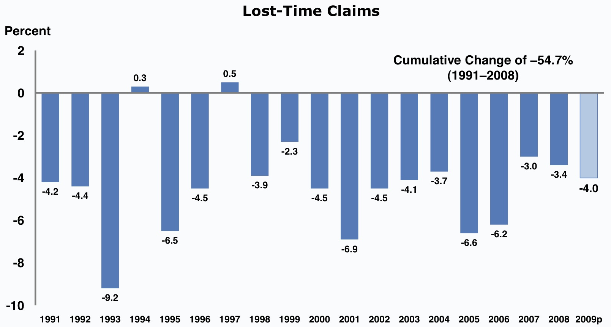
The Good News… Claim Frequency Dropped 55% 1991 - 2009

Slide 10
The Bad News… Medical Costs Tripled, 1991 - 2007

Slide 11
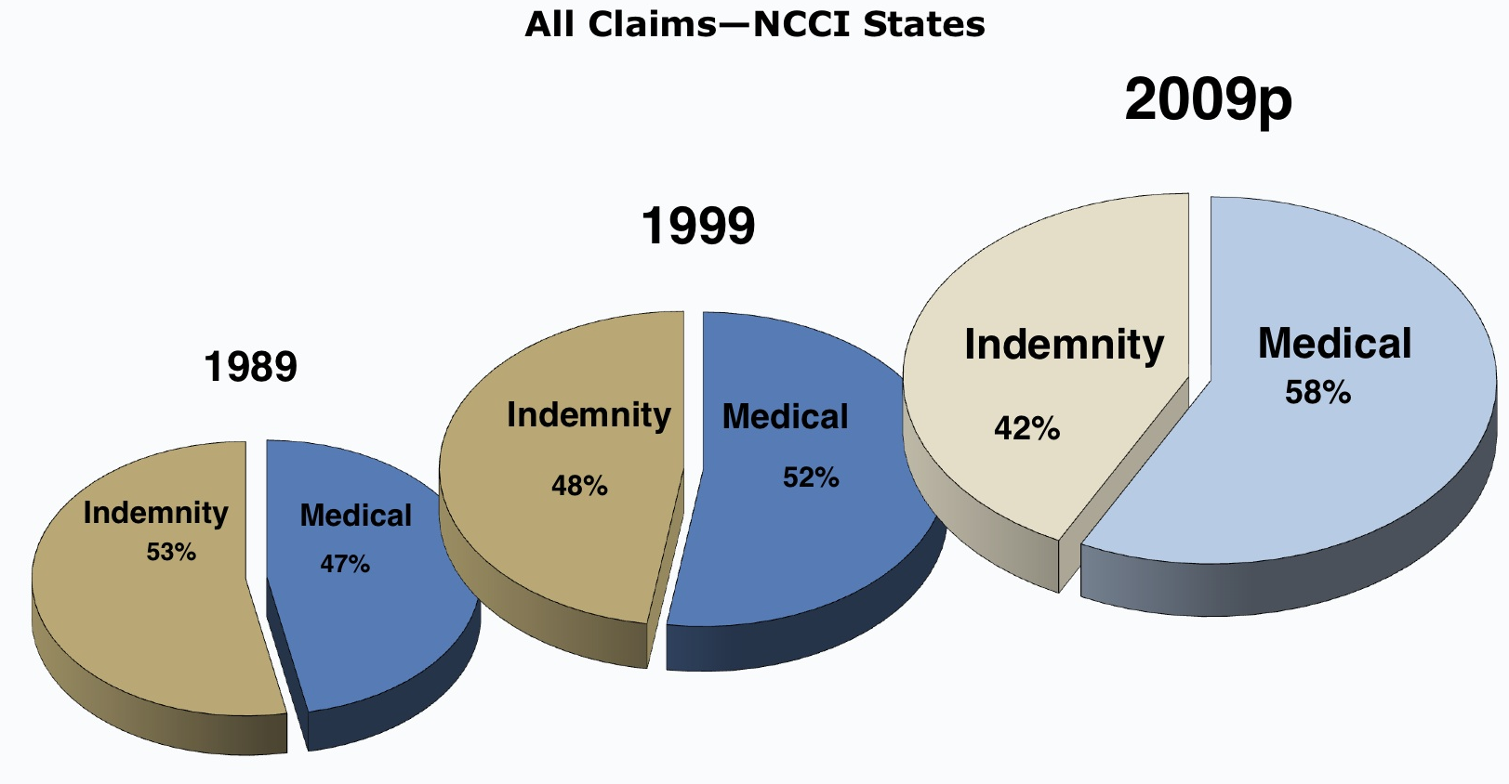
Medical Costs Should Have Your Attention Medical Costs Are Taking An Ever Increasing Share Of the WC Dollar

Slide 12
Modern Medical Management Has Become A Growth Industry
From 2002 to 2007 in CA, average paid medical benefits spent on medical cost-containment expenses increased 234% (from 4.7% to 11%).
A growth rate that tripled the growth rate of medical costs.
Notes:
It took medical cost 16 years to triple… It took medical management providers did that in almost 5 years.

Slide 13
Medical Management Providers Will Point To Their Savings…
But, one risk manager exclaimed in an interview with Risk & Insurance, “They are saving me to death.”

Slide 14
Three Core Cost Containment Strategies
Front-End Controls – Utilization
Negotiated Pricing – Price
Back-End Controls – Enforcement
Notes:
Let’s look at what they do…

Slide 15
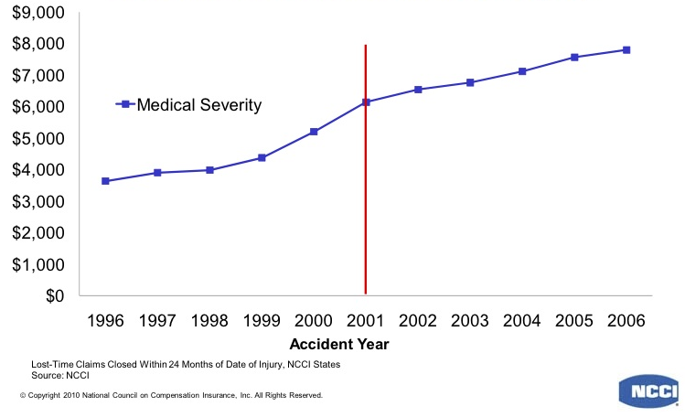
Medical Severity for Lost-Time Claims Utilization went from a 62% cost-driver, to a cost-containment factor
21%
51%
Diagnosis Mix = 19%
# Of Treatments = 62%
Price & Other = 19%
Diagnosis Mix = 3%
# Of Treatments = -11%
Price & Other = 98%
Notes:
NCCI study, 2010. Looked at increasing costs and severity. Assessed key drivers

Slide 16
Front-End Controls
Utilization Review Works...
but, it is an expensive and grossly inefficient process that presents serious management issues

Slide 17
An Inefficient Process…
On average, 80% of UR requests are approved; only 20% result in a delay, modification or denial
Notes:
Even with an 80% waste factor, UR does produce a positive ROI. The most conservative review I’ve read shows a 150% ROI. That is where the medical management companies would like to stop. But, how much is that waste costing us and is there anything we can do?

Slide 18
Calculating The $ Waste In UR Ops… (Avg Medical Cost & Avg Treatments Per Claim from NCCI Data)
Avg. Medical Cost Per Indemnity Claim = $26,000
Avg. Treatments Per Claim = 56
Avg. 1st level UR cost: $100 to $125
Est. Op Cost Per Claim for 1st level UR:
$5,600 to $7,000 Per Claim (22% - 27% of Total Medical Cost)
Avg. Rate of UR Approvals: 80%
Avg. Wasted UR Operating Expense Per Claim: $5,000
(and this does not account for waste in delayed treatments, increased paperwork, regulatory requirements…)

Slide 19
Can we create a targeting technology to clean out a portion of the waste?
Suggested Reading: The Innovator's Dilemma, by Clayton Christensen
(Smart-UR, our beta technology designed to address targeting and pre-auth of UR requests, launched 1/9/09; retired in 2011 and replaced with BaseLine – a medical management platform.)
Notes:
Smart-UR was a rudimentary technology that looked at a current request, looked back into the clam history to identify previous approvals, then looked at a very basic protocol list to target those requests that could and would likely be approved.

Slide 20
Expected Outcome of Pre-authorization Program
With our initial app, we eliminated 60% of the requests via our pre-auth application.
Thus, the resulting pie chart should have looked like this…

Slide 21
But, that’s not what happened…
Notes:
Please see the book “The Innovator’s Dilemma”. It discusses the response of established industries to innovations that provide a limited technology, at a lower price point, serving a smaller market share. – How do you think they responded?

Slide 22
How did the Caduceus respond to the Destructive Technology? Business as usual!
Even though we eliminated 60% of the request pool through our pre-auth program…
The URO outcomes remained 80/20 on what was sent to them…
This was consistent across three UROs.
Notes:
We of course, wondered, what happened to the other 16% of the requests that were previously being denied, modified or delayed.

Slide 23
A riddle, wrapped in a mystery, inside an enigma… boils down to self-interests
Notes:
They did not recognize that the game had changed. They were motivated to maintain their status quo. Their nurses had to approve a certain number to justify their costs… When we confronted them we got no where… that is what lead to understanding that Smart-UR while a great application was not robust enough for the job. So, let’s turn now to the second level of our cost containment arsenal…

Slide 24
Negotiated Pricing
Seems simple enough. Negotiate preferred prices and send all your referrals to the preferred vendors.
Notes:
Simple enough… but, when you talk to the ancillary vendors you get a different picture…

Slide 25
It is estimated by many ancillary vendors that leakage consumes in excess of 30% of their potential business.
This means that 30% of the expected negotiated savings to the payor is marginalized.
Notes:
This has led to all sorts of interesting developments in the medical management industry.

Slide 26
The evidence supports this reality, but the typical response is…
“Maybe that’s true at XYZ… But that can’t happen here, our systems are tight…
Notes:
I should note here, if I haven’t already, that I am not just addressing medical companies in this talk. But, all the various stakeholders in the process; including claims and risk managers as well. There are actually very interesting “battles” going on between the “buyer” and the “seller”. But, before we go there, let’s look at our third line of defense,

Slide 27
Back-End Controls
Bill Review is the back-end enforcement mechanism for medical cost control.
Bill Review is basically a technological solution to enforce such things as fee schedules, ppo discounts, negotiated discounts…
Bill Review Works, and
Bill Review is Cost-Effective and Efficient!
Notes:
Finally, something that works… Right?

Slide 28
Unfortunately…
Bill Review is the enforcement tool, but it:
Can’t control for operational waste.
Can’t control for non-compliance.
Is plagued with ineffective communication systems that allow for significant leakage.
Notes:
Well, maybe not.

Slide 29
“I know others have this problem, but our program works”
Notes:
These problems eventually boil up to the risk manager… who has big stake in being able to tell his bosses that his program works…

Slide 30
So, What Have We Got?

Slide 31
Notes:
We have an old established system that is being forced to work beyond its capacity and is showing its wear. No matter how you look at it it’s a challenge.

Slide 32
“There are known knowns; there are things we know we know. We also know there are known unknowns; that is to say we know there are some things we do not know. But there are also unknown unknowns – there are things we do not know we don't know.” Donald Rumsfeld, Sec of Defense
Notes:
I like what Donald Rumsfeld said about dealing with complex issues. It can be dealt with, but not without risk.

Slide 33
Riddle, Mystery, Enigma
…something that is complex, difficult to understand and even harder to explain…
Notes:
So, we have begun to define the problem. And it’s not just them, it’s us too! Let’s take a look at complexity.

Slide 34
The Complexity of Workers’ Comp…
Complexity from 30,000 ft…
External issues -- multiple and often conflicting laws, regulations and policies, multiple stakeholders with conflicting agendas and interests, huge investments, loads of money…,
Institutional Issues – Strategic directions and choices regarding operational structures, goals, objectives, systems, processes...
Notes:
Unfortunately, the folks that propose the institutional solutions to these complexities, which appear simple, doable and elegant at the 50,000 ft level, are seldom the ones that have to implement these solutions.

Slide 35
Institutional vs Individual Complexity The 30,000 ft solutions often don’t fly at ground level
How do we get things done around here?
How do your employees experience and deal with the 30,000 ft solutions to complexity…

Slide 36
When you focus on form rather than the pertinent functional issues, you stifle performance
Notes:
For example, CO has employer choice of Docs. So UR is basically yes. Due to press coverage of success of UR in CO other states are adopting the CO guidelines; but they don’t have employer choice, it’s employee choice… And the front-lines are expected to produce the CO results… go Figure.

Slide 37
This stuff fosters organizational neuroses (Some might suggest psychosis)
Destroys staff morale;
Robs the organization of its productivity and effectiveness;
Contributes toward mediocrity and low-quality commitment;
Frustrates and damages the peace of mind of both management & employees;
Causes organizations to take illogical, crazy actions;
Renders efforts to improve quality virtually irrelevant;
Demonstrates a very high potential for destroying leadership and the organization
Notes:
These issues create real problems for organizations. Most claims people I know today, say they would never go back into this business today.

Slide 38
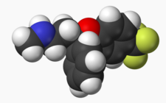
Where’s my Prozac?
Function Needs To Drive Form
Conduct a reality check with the boots on the ground
You will need to get in there and deal with those old rusty leaky pipes.
You need to understand the demands and workflows at the front-lines of the organization. This means:
Identify and reduce bottlenecks
Adjust select organizational and operational models
Clarify roles & capabilities
Define accountabilities
Notes:
Remember the leaky water system! You probably can’t change the entire system, but you can focus on the leaks.

Slide 39
Think Small
Less-Threatening Approach… An objective of releasing a few workflow issues will not tend to be immediately threatening to the owners of the institutional complexities.
Create Indirect Impacts… When you release the handicaps on workflow and production, productivity outcomes begin to improve; which, relieves many of the institutional pressures and aberrations.
Produce Breathing Room… The result is that the institutional complexity space becomes less dense.
Gain Time to Think and Refocus…Thus, the company can pursue more challenging and value enhancing strategies and increase organizational productivity and resilience.
Notes:
Sounds simple Right? Remember though, you can make these changes, but you still have to deal with the caduceus…

Slide 40
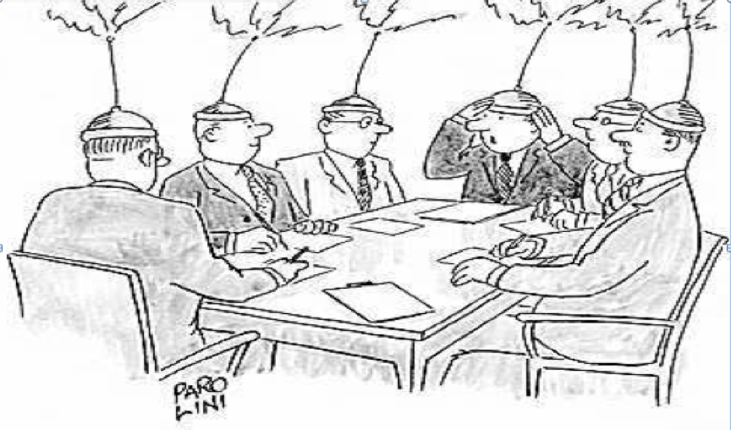
So gentlemen, now that we’ve got out the thinking caps, we can resume.
Notes:
We we began managing medical management, we started at the 50,000 foot level. It didn’t work. We didn’t give up our strategy, we did however change our tactics. Until you work through these challenges, everything else is extraneous.

Slide 41
So You Want To Manage Medical Management…
Notes:
This is not an easy thing to manage. But, if they actually appeared to us in this image, it would be easier… You would cut their heads of and be done with it. Unfortunately, it’s not that easy.

Slide 42
Workers’ Comp is a commodity…
Effective marketing strategists know you.
They know that you want to feel special.
They can deliver that feeling to you without you even knowing it.
That’s what makes you loyal to their brand.
Notes:
Everyone says the WC is a commodity business. It is. But so is men’s underwear. Not a fashion statement. But very loyal, perceived values. The calvin klein story. Bottom line, they know you and your buying habits better than you.

Slide 43
The reality of WC is not much different from the reality of men’s underwear.
Estimated market for men’s underwear in CA is around $3.75 Billion
Just the PC Premium Dollars in CA estimated at $7.1 Billion
Notes:
Consider what you are up against. With this much money involved, do you think you are not facing these same strategies and tactics. Tell the TPA story. 2 = 50% (aspirational), 13 at 40% (features & benefits); 10 at 10% (mom and pops). Managing this is very tough because for the most part it is going on below your awareness.

Slide 44
Aspiration VS Reality
The battle is for the control of what you see and feel; and where your attention gets focused.
Notes:
NEXT: The reality of worker’s comp.

Slide 45
“…even when risk managers have the best of intentions, getting their hands on meaningful data can be a tall order.”
CFO Magazine, “A Refresher Course on Workers Comp
Notes:
NEXT: There are very complex systems. (follow the money)

Slide 46
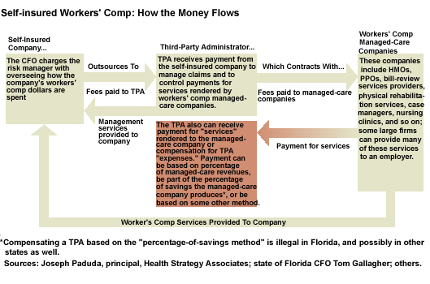
Notes:
A lot of work has been done to begin to control this. But, it is still an issue. “Claims Management” article on Selling Broker Relationships to Upper Management…

Slide 47
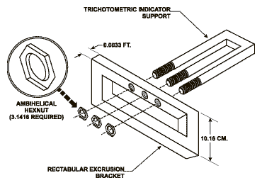
“We are proud to present our simplified bundled business model…”
Notes:
It’s a game.

Slide 48
Our performance reports are clear, concise, and totally transparent…
Notes:
On the surface things seem perfectly clear..

Slide 49
Until you cut through the clutter…

Slide 50
How can you get a handle on all this?

Slide 51
you can’t

Slide 52
but, technology can

Slide 53
The BaseLine Platform
Automates Complex Workflows
Manages Multiple Stakeholders
Audits Expected Performance
Which means our clients spend less, do more & manage better.

Slide 54
We designed BaseLine to simplify a very complex and dynamic system.
Institutional Complexity:
BaseLine doesn’t require significant IT investments or replacement.
BaseLine doesn’t require a change of vendors.
BaseLine is consistent with policies, procedures and regulations.
Individual Complexity:
BaseLine streamlines workflows to maintain system integrity and reduce costs of operation.
BaseLine delivers interoperability and transparency between corporate and vendor-driven technologies.
BaseLine delivers standardized measurable performance accountability between multiple stakeholders and vendors.
Do What You Do Best!

Slide 55
A Few Things Technology Can’t Fix…

Slide 56
The Mission of a Corporation is to Maximize Shareholder Wealth by Fulfilling the Organizational Objective
The role of risk management is directed to prevent and eliminate disruptions in the delivery of services/products and retain the wealth acquired through the operations of the company.

Slide 57
As social animals, we will walk willingly into an obvious danger rather than risk appearing anti-social, ignorant or not totally in charge.

Slide 58
Managing Medical Management Requires Less Management & More Leadership.
A manager works within the complexity of the organization, protecting and supporting it. A leader works on the complexity of the organization, creating it or changing it.
Notes:
You need to be engaged in your corporate mission.

Slide 59
So gentlemen, now that we’ve got out the thinking caps, we can resume.
Well, that sounds simple enough. Let’s review…
Notes:
Let’s resume

Slide 60
A riddle, wrapped in a mystery, inside an enigma…
Medical Management is a sophisticated process with many complex and moving parts.
There are many powerful stakeholders (both internal and external) who are intelligent and have significant financial and organizational interests to protect.
Most technologies in WC medical management have not seriously contributed to an increase in effectiveness, because they:
Serve form (institutional) issues rather than functional (front-line) issues, and,
Many of the technologies in the system are vendor-driven and serviced.
Technologies that don’t play well together and are prone to opaque transactions and are vehicles for distraction and misdirection.

Slide 61
Medical Cost Containment Will Not Be Achieved With A Contract
You need to be hands-on and on the front-line.
Your systems may be highly complex, but they must be essentially simple.
You need technologies that facilitate a clean and transparent workflow that:
Can provide for automation of routine tasks and decisions.
Can manage key information from/to multiple stakeholders, with disparate systems and often times representing competing interests.
Can audit for performance.

Slide 62
Solve the riddle, unwrap the mystery, crack the enigma.
BaseLine is a “vendor-neutral” technology that greatly simplifies life on the front-lines.
BaseLine allows the users throughout the company to focus on the decisions only they can address; while the technology handles all the necessary but routine tasks and decisions.
BaseLine brings transparency and accountability to the process by delivering a platform that makes systems interoperable and reports the key data in an unfiltered, unbiased environment.
BaseLine delivers a significant reduction in operating costs and captures substantial savings being lost through system leakage and poor communication.
Do What You Do Best!

Slide 63
BaseLine
Automate. Manage. Audit.
James A. Schlueter, President
Effective Health Systems, Inc.
Denver WC RIMS/SHRMC Conference
March 23, 2012

